Slide 1

Air Force Explorers
UNCLASSIFIED
AI - General Intelligence: Introduction to Intelligence
&
Anti-Terrorism & Security Programs
Prepared by:
Capt. Matthew Sergent, Chief A2–Air Intelligence
Hqs – Air Force Explorers
UNCLASSIFIED

Slide 2

Agenda
UNCLASSIFIED
PART I - GENERAL INTELLIGENCE –
INTRODUCTION
History
Intelligence Community
Categories
  HUMINT
  SIGINT
  IMINT
  GEOINT
  CRYPTO
  OSINT
Exercises
Recommendations
UNCLASSIFIED

Slide 3
History
UNCLASSIFIED
“World Second Oldest Profession”
  Biblical roots
  Spying is the “oldest profession” on this idiom
Julius Caesar
  Caesar Ciphers
Washington’s Spies
  The necessity of procuring good Intelligence is apparent & need not be further urged -- All that remains for me to add is, that you keep the whole matter as secret as possible.”
  General Benedict Arnold, September 1780
World War 1
  Mata Harri- Femme Fatale
  Open Radio Communications on the Eastern Front
World War 2
UNCLASSIFIED

Slide 4
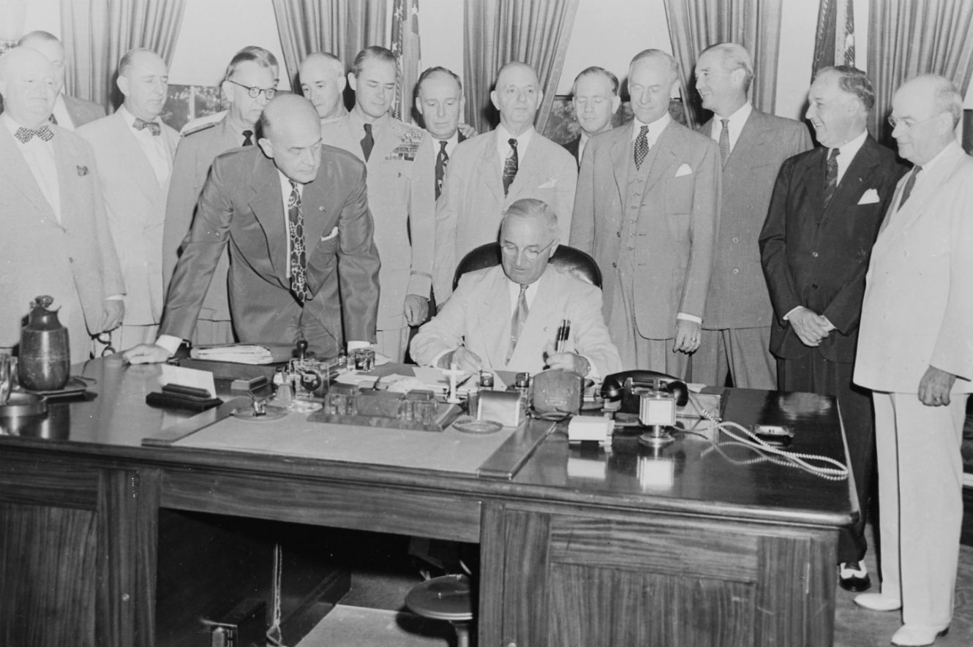
National Security Act of 1947
UNCLASSIFIED
Enacted 26 July 1947
Provided the framework for the majority of the modern US Military
Established Intelligence Agencies to include:
  National Security Council
  Central Intelligence Agency
  National Security Agency
Intelligence Community (IC)
UNCLASSIFIED

Slide 5
Intelligence Community (IC)
UNCLASSIFIED
Executive Order 12333, Signed 4 Dec 1981
  Established the IC
  Headed by the Office of the Director of National Intelligence (ODNI)
  Major upset for DCI, CIA
Seventeen Members
  16th Air Force (USAF ISR)
  Defense Intelligence Agency
  National Security Agency
  National Reconnaissance Agency
  National Geospatial Intelligence Agency
UNCLASSIFIED

Slide 6
Human Intelligence
UNCLASSIFIED
Intelligence Community Directive 300:
  Defines as “a category of intelligence derived from information collected and provided by human sources”
Four Main Sources of HUMINT:
  Clandestine acquisition of photography, documents, and other material.
  Overt collection by people overseas.
  Debriefing of foreign nationals and U.S. citizens who travel abroad.
  Official contacts with foreign governments.
UNCLASSIFIED

Slide 7
Signals Intelligence
UNCLASSIFIED
ICD 300- NSA is the SIGINT Manager
  Defined as “Intelligence derived from electronic signals and systems used by foreign targets, such as communications systems, radars, and weapons systems that provides a vital window for our nation into foreign adversaries' capabilities, actions, and intentions.
Subcategories
  Communications Intelligence (COMINT),
  Electronic intelligence (ELINT)
  Foreign Instrumentation Signals Intelligence (FISINT).
UNCLASSIFIED

Slide 8
Imagery Intelligence
UNCLASSIFIED
Imagery Intelligence
  “IMINT is intelligence derived from the exploitation of imagery collected by visual photography, infrared, lasers, multi-spectral sensors, and radar. These sensors produce images of objects optically, electronically, or digitally on film, electronic display devices, or other media.”
Cuban Missile Crisis
  IMINT verified the presence of ballistic missile on Cuba.
UNCLASSIFIED

Slide 9
Geospatial Intelligence
UNCLASSIFIED
National-Geospatial Intelligence Agency (NGA) is the GEOINT Manager
“GEOINT is the exploitation and analysis of imagery and geospatial information to describe, assess and visually depict physical features and geographically referenced activities on the Earth. GEOINT consists of imagery, imagery intelligence and geospatial information.”
GEOINT can be gleaned from several private sources
  Google Maps
UNCLASSIFIED

Slide 10
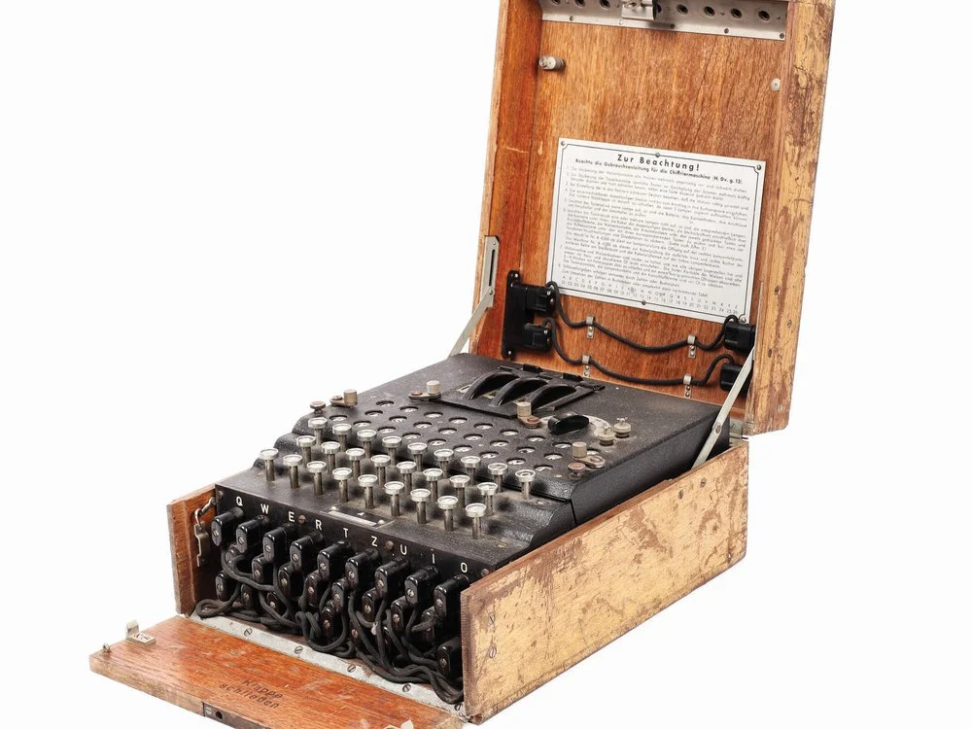
Cryptography
UNCLASSIFIED
NSA: Agency Charged with Cryptography, and Communications Security (COMSEC)
Encryption is as important today as it is throughout history.
“Study of secure communications techniques that allow only the sender and intended recipient of a message to view its content”
Ciphers:
  Caesar Cipher
  AES-256 Bit encryption
UNCLASSIFIED

Slide 11
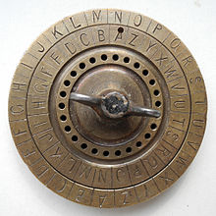
Caesar Cipher Exercise
UNCLASSIFIED
LQWHOOLJHQFH
Key = -3
UNCLASSIFIED

Slide 12
Open Source Intelligence
UNCLASSIFIED
Open-source intelligence (OSINT) is the collection and analysis of data gathered from open sources to produce actionable intelligence.
Categories:
  Media
  Internet
  Public government Data
  Publications
  Commercial Data
83% of all intelligence gathered by Al-Qaeda
Commercial Targeting by large search engines
UNCLASSIFIED

Slide 13

“Google Yourself”
UNCLASSIFIED
Open-Source Exercise
What does the first page of google say about you?
How is your Social media security?
Any pictures of you on the internet?
Voluntary: Share with the class what you found.
UNCLASSIFIED

Slide 14

Recommendations
UNCLASSIFIED
Overview of the many intelligence disciplines
Develop a greater appreciation of intelligence on a strategy scale
Understand the importance of security for your information
UNCLASSIFIED

Slide 15



Agenda
UNCLASSIFIED
PART 2 - ANTI-TERRORISM &
SECURITY PROGRAMS
USAF Anti-Terrorism
INFOCON SYSTEM
USAF EAGLE EYES
DOD FORCE PROTECTION CONDITION (FPCON)
    (Base Security Conditions)
UNCLASSIFIED

Slide 16
USAF Anti-Terrorism Program
UNCLASSIFIED
Objective: AF AT Program – seeks to deter or blunt terrorist acts against the U.S. Air Force by:
                --- Giving guidance on collecting & disseminating
                timely threat information.
                --- Creating awareness programs & implement
                defensive measures.
                ALL EXPLORER PERSONNEL:
                --- Be aware of & active in the AF AT Program
                --- Individuals be attentive to the surroundings of
                installation you may be on.
UNCLASSIFIED

Slide 17

USAF Anti-Terrorism Program
UNCLASSIFIED
Attacks on Military base facilities have increased across the U.S. & worldwide.
Attacks may be religious, moral or socially defined in behavior and action.
Even from those who are serving under false pretenses.
Main Target general areas:
  --- Aircraft ramp and aircraft.
  --- Communication facilities.
  --- Recruiting displays
UNCLASSIFIED

Slide 18
USAF Anti-Terrorism Program
UNCLASSIFIED
Responsibility of all personnel:
--- Be AWARE and PROACTIVE in a stance
concerning the AT Program.
--- The IN section of your Explorer Unit is the
OPR for the AT Program.
--- All questions or comments should be
directed immediately to IN…
--- THEN Unit Commander AND Military
Base Security Forces personnel.
UNCLASSIFIED

Slide 19
Definition of Terrorism
UNCLASSIFIED
Terrorism is defined as
the calculated use of violence or the threat of
violence to inculcate fear
--- intended to coerce or to intimidate
governments or societies
--- in the pursuit of goals that are generally
1. Political
2. Religious or
3. Ideological.
(DOD Definition)
UNCLASSIFIED

Slide 20
INFOCON SYSTEM
UNCLASSIFIED
INFOCON is a
defense system based primarily on
--- the status of INFORMATION SYSTEMS
and is a
--- METHOD used by the military to defend
against a computer network attack.
UNCLASSIFIED

Slide 21
INFOCON SYSTEM
UNCLASSIFIED
FIVE (5) LEVELS OF INFOCON:
INFOCON 1: No apparent hostile activity
INFOCON 2: Increased risk of attack
INFOCON 3: Risk has been taken place
INFOCON 4: Attack has taken place
INFOCON 5: Attacks are taking place, maximum
alertness, compromised systems
isolated from the net.
UNCLASSIFIED

Slide 22
EAGLE EYES PROGRAM
UNCLASSIFIED
Eagle Eyes is a
definitive reporting program for the individual if you think or suspect an event may take place or certain individuals look suspicious or out of place
--- Do not hesitate to make someone aware.
--- Here is what to Report.
UNCLASSIFIED

Slide 23
EAGLE EYES PROGRAM
UNCLASSIFIED
What to Report:
Surveillance – Using cameras (either still or video), note taking, drawing diagrams, writing on maps, or using binoculars or other vision-enhancing devices to record or monitor base activity.
UNCLASSIFIED

Slide 24
EAGLE EYES PROGRAM
UNCLASSIFIED
What to Report:
Elicitation – Attempts to gain information from you by mail, in person, or by telephone about military operations, capabilities, or people.
UNCLASSIFIED

Slide 25
EAGLE EYES PROGRAM
UNCLASSIFIED
What to Report:
Tests Of Security - Attempts to measure reaction times or penetrate physical security barriers or procedures in order to assess strengths and weaknesses.
UNCLASSIFIED

Slide 26
EAGLE EYES PROGRAM
UNCLASSIFIED
What to Report:
Acquiring Supplies – Purchase, theft, or unauthorized acquisition of explosives, weapons, ammunition, military uniforms, decals, flight manuals, passes or badges, or any other controlled items.
UNCLASSIFIED

Slide 27
EAGLE EYES PROGRAM
UNCLASSIFIED
What to Report:
Suspicious Persons Out Of Place – People who don’t seem to belong in the workplace, neighbor-hood, business establishment, or anywhere else.
UNCLASSIFIED

Slide 28
EAGLE EYES PROGRAM
UNCLASSIFIED
What to Report:
Dry Run – People getting into position and moving around according to their plan without actually committing a terrorist act. This could also include mapping out routes and determining the timing of traffic lights and flow.
UNCLASSIFIED

Slide 29
EAGLE EYES PROGRAM
UNCLASSIFIED
What to Report:
Deploying Assets – People and supplies getting into position to commit the act. This is a person’s last chance to alert authorities before the terrorist act occurs.
UNCLASSIFIED

Slide 30

EAGLE EYES PROGRAM
UNCLASSIFIED
Be Prepared to:
• Give your name and company
• Give your location (as clearly and accurately as you can—give a building name, number or street)
• Provide a call back phone number
• Remain at your location until contacted by Security Forces
• Move to a location as directed by the Emergency Response Center
UNCLASSIFIED

Slide 31
DOD Force Protection System (FPCON)
UNCLASSIFIED
FPCON is a…
A JCS approved program standardizing the military services’ identification of, and recommended responses to, terrorist threats against US personnel and facilities. This program facilitates inter-service coordination and support for antiterrorism activities.
Military services are always in one of the following five postures. The conditions below are listed in order from normal peacetime to when an attack has actually occurred.
UNCLASSIFIED

Slide 32
DOD Force Protection System (FPCON)
UNCLASSIFIED
FIVE FORCE PROTECTION CONDITIONS:
FPCON “DELTA”
FPCON “CHARLIE”
FPCON “BRAVO”
FFCON “ALPHA”
FPCON “NORMAL”
UNCLASSIFIED

Slide 33
DOD Force Protection System
(FPCON)
UNCLASSIFIED
UNCLASSIFIED

Slide 34
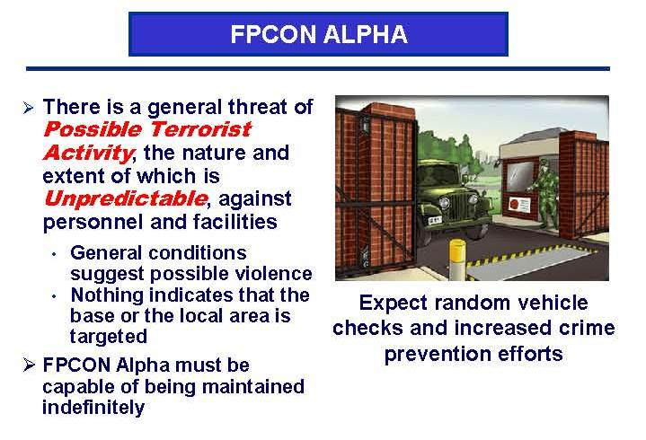
DOD Force Protection System (FPCON)
UNCLASSIFIED
UNCLASSIFIED

Slide 35
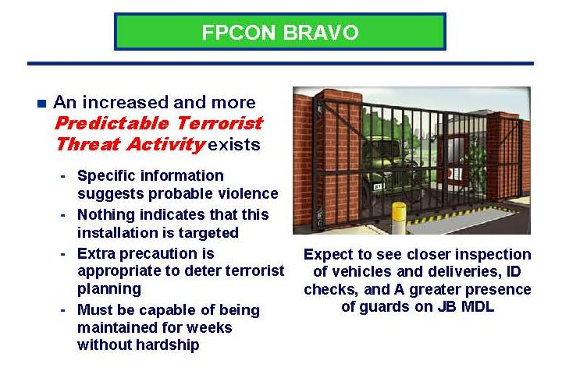
DOD Force Protection System (FPCON)
UNCLASSIFIED
UNCLASSIFIED

Slide 36
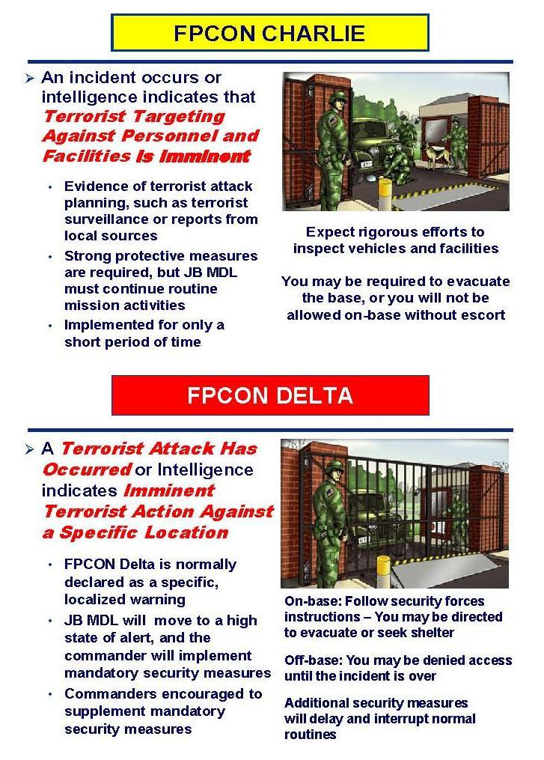
DOD Force Protection System (FPCON)
UNCLASSIFIED
UNCLASSIFIED

Slide 37
DOD Force Protection System (FPCON)
UNCLASSIFIED
UNCLASSIFIED

