Slide 1
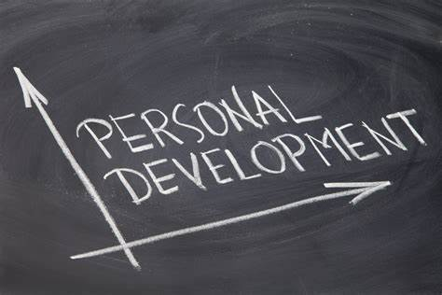
PERSONAL DEVELOPMENT
COURSE
PART 4:
SUCCESSFUL
ATTITUDES OF LIFE

Slide 2
THE PERSONAL DEVELOPMENT COURSE (Young Adults Version) was written and developed by Tom Block, 1 June 2022 and printed / published by Starlifter Publications, P.O. Box 324, Butler, WI 53007.
REFERENCES:
“THE AMERICA WE KNOW” (on American Exceptionalism) –(Author by Tom Block), including its unpublished new 2nd Edition.
“The 5,000 Year Leap” (Authored by W. Cleon Skousen)

Slide 3
Class Subjects:
4 - SUCCESSFUL ATTITUDES OF LIFE
Getting your Attitude Straight
How do you spell S-U-C-C-E-S-S?
Positive Attitude Statements
Persistence
How do Successful People get that way?
Don’t Quit!
Other Successful Attitudes

Slide 4
A. Getting your Attitude Straight:
4 - SUCCESSFUL ATTITUDES OF LIFE
Intro…
Achieving worthwhile SUCCESS for anyone must start with individually attaining a Positive Mental Attitude (PMA).
Achievement attained through some combination of PMA and definiteness of purpose with one or more of some of the well-known success principles.
A PMA is the right attitude in a given environment.
We in America know what it is for us: we have inherited, the tenets of the Judeo-Christian faiths on which our Constitution, laws, and customs have been based.

Slide 5
A. Getting your Attitude Straight:
4 - SUCCESSFUL ATTITUDES OF LIFE
Developing a PMA…
Here are a few illustrations on how you can develop a Positive Mental Attitude:
1. Be considerate and sensitive to the reaction of others.
2. Be sensitive to your own reaction. (in other words) Learn to control your emotional response to any environmental influences, especially negative ones.
3. Be a ‘GOOD’-finder… in other words, LOOK for the good in any situation.

Slide 6
A. Getting your Attitude Straight:
4 - SUCCESSFUL ATTITUDES OF LIFE
4. Believe that any goal that doesn’t violate the laws of God or the rights of your fellowmen can be achieved.
5. Develop what are understood to be right habits of thought and action
NOTE: To give you some ideas how successful people think and feel, were going to give you some actual attitudes and behavior from those who have achieved SUCCESS.

Slide 7
A. Getting your Attitude Straight:
4 - SUCCESSFUL ATTITUDES OF LIFE
… as we mentioned in our class on ‘LIFE CHOICES’, with all the Good things that happen in our world, comes the bad:
We will get down at times through our struggles throughout life. THAT IS PART OF LIFE AND SOME OF THOSE THINGS HAPPEN TO ALL OF US!:
BREAKDOWNS --- BREAKUPS --- SCREWING UP
STRUGGLES THROUGH OUR CHALLENGES
BREAK UPS, EXPERIENCING HAVING TO STUDY THROUGH A COURSE THAT IS NOT OUR FAVORITE --- BAD GRADES --- TEACHERS/CLASSES WE STRUGGLE THROUGH SOMETIMES WE THINK IS THE WORST---
STRESS FROM HOME / PARENTS, BROTHERS, SISTERS
PEER PRESSURE FROM FRIENDS, ETC, ETC, ETC.

Slide 8
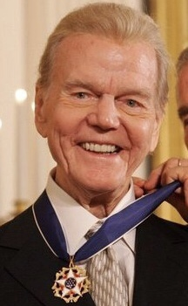
A. Getting your Attitude Straight:
4 - SUCCESSFUL ATTITUDES OF LIFE
WE NEED TO: “Pick ourselves up! And MOVE ON!
PAUL HARVEY (a highly popular Radio Talk Show Personality 1951-2008) … maybe like the late, Rush Limbaugh (30 Yr+ Conservative Talk Host) or of Joe Rogan of today.
Paul Harvey said this of failure or How we measure Success:
"Success is measured not by how much aggravation you can dish out, but how much aggravation you can take“.
"Success is not measured by how far up you go, but how far up you bounce when you fall".

Slide 9
B. How do you spell S-U-C-C-E-S-S?:
4 - SUCCESSFUL ATTITUDES OF LIFE
THIS IS ONE JUST AUTHOR’S EXAMPLE…
S - SENSE OF DIRECTION (..is having Goals/Projects.)
U - UNDERSTANDING (Depends on good communication. Don't look at who's right, but what's right.)
C - COURAGE (...to act out our goals into realities. Take risks. Act boldly on little things.)
C - CHARITY (Not just the act of giving, having respect for others. Act as if other people & their feelings are
important to you.)
E - ESTEEM (Appreciate the worth and value of other people. Complement people when you can.)
S - SELF-CONFIDENCE (Success breeds success. Remember your past successes and forget your failures.)
S - SELF-ACCEPTANCE (RELAX. BE YOURSELF. Making mistakes DOES NOT mean YOU are a
mistake!

Slide 10
C. Positive Attitudes of Success:
4 - SUCCESSFUL ATTITUDES OF LIFE
Here are some of the better know Attitudes for Success…
General:
1. WHATEVER YOUR MIND CAN CONCEIVE AND BELIEVE,
IT WILL ACHIEVE. --- (by Napoleon Hill, Author of “Think and Grow Rich”)
2. DREAM GREAT DREAMS AND MAKE THEM COME
TRUE. (You must start with a Dream!)
3. DO IT NOW. (an Anti-Procrastination Statement)

Slide 11
C. Positive Attitudes of Success:
4 - SUCCESSFUL ATTITUDES OF LIFE
Have A Belief in Yourself:
1. YOU ARE UNIQUE.
2. IN ALL THE HISTORY OF THE WORLD THERE WAS NEVER ANYONE ELSE EXACTLY LIKE YOU, AND IN ALL THE INFINITY TO COME THERE WILL NEVER BE ANOTHER LIKE YOU.
3. NEVER AFFIRM YOUR SELF-LIMITATIONS.
4. WHAT YOU BELIEVE IN YOURSELF TO BE, YOU ARE.
5. TO ACCOMPLISH GREAT THINGS, YOU MUST NOT ONLY ACT, BUT ALSO DREAM; NOT ONLY PLAN, BUT ALSO BELIEVE.

Slide 12
C. Positive Attitudes of Success:
4 - SUCCESSFUL ATTITUDES OF LIFE
Have A Belief in Yourself:
IF YOU BUILT CASTLES IN THE AIR, YOUR WORK NEED NOT BE LOST-PUT FOUNDATIONS UNDER THEM.
YES YOU CAN.
BELIEVING IS MAGIC.
YOU CAN ALWAYS BETTER YOUR BEST.
10. WHAT EVER YOU BELIEVE IN YOURSELF, IT WILL PROBABLY
MAKE IT UNAMIMOUS.
(If you don’t, nobody else will either!)

Slide 13
C. Positive Attitudes of Success:
4 - SUCCESSFUL ATTITUDES OF LIFE
Taking Risks in order to Succeed:
YOU DON'T KNOW WHAT YOU CAN DO UNTIL YOU TRY.
NOTHING WILL COME OF NOTHING.
IF YOU DON'T GO OUT ON A LIMB, YOU'RE NEVER GOING TO GET THE FRUIT.
THERE IS NO FAILURE EXCEPT IN NO LONGER TRYING.
JUST DON'T LOOK BACK UNLESS YOU WANT TO GO THAT
WAY.

Slide 14
C. Positive Attitudes of Success:
4 - SUCCESSFUL ATTITUDES OF LIFE
MUST have Goals:
IF YOU DON’T KNOW WHERE YOU ARE GOING, YOU ARE NOT GOING TO GET THERE.
2. HAZY GOALS PRODUCE HAZY RESULTS.
3. CLEARLY DEFINE YOUR GOALS.
WRITE THEM DOWN, MAKE A PLAN FOR ACHIEVING THEM,
SET A DEADLINE, VISUALIZE THE RESULTS AND GO AFTER
THEM.

Slide 15
C. Positive Attitudes of Success:
4 - SUCCESSFUL ATTITUDES OF LIFE
You may Stumble along the Way… pick yourself up and continue:
DEFEAT WILL TEST YOU; IT NEED NOT STOP YOU.
IF AT FIRST YOU DON'T SUCCEED, TRY ANOTHER WAY.
FOR EVERY OBSTACLE THERE IS A SOLUTION.
NOTHING IN THE WORLD CAN TAKE THE PLACE OF PERSISTENCE.
THE GREATEST MISTAKE IS GIVING UP – DON’T QUIT!

Slide 16
C. Positive Attitudes of Success:
4 - SUCCESSFUL ATTITUDES OF LIFE
In summation:
WISHING WILL NOT BRING SUCCESS, BUT PLANNING, PERSISTENCE AND A BURING DESIRE WILL.
THERE IS A GOLD MIND WITHIN YOU FROM WHICH YOU CAN EXTRACT ALL THE NECESSARY INGREDIENTS.
SUCCESS IS AN ATTITUDE
-- GET YOURS RIGHT!
~ ~ ~ IT IS ASTONISHING HOW SHORT A TIME IT TAKES
FOR VERY WONDERFUL THINGS TO HAPPEN ~ ~ ~

Slide 17
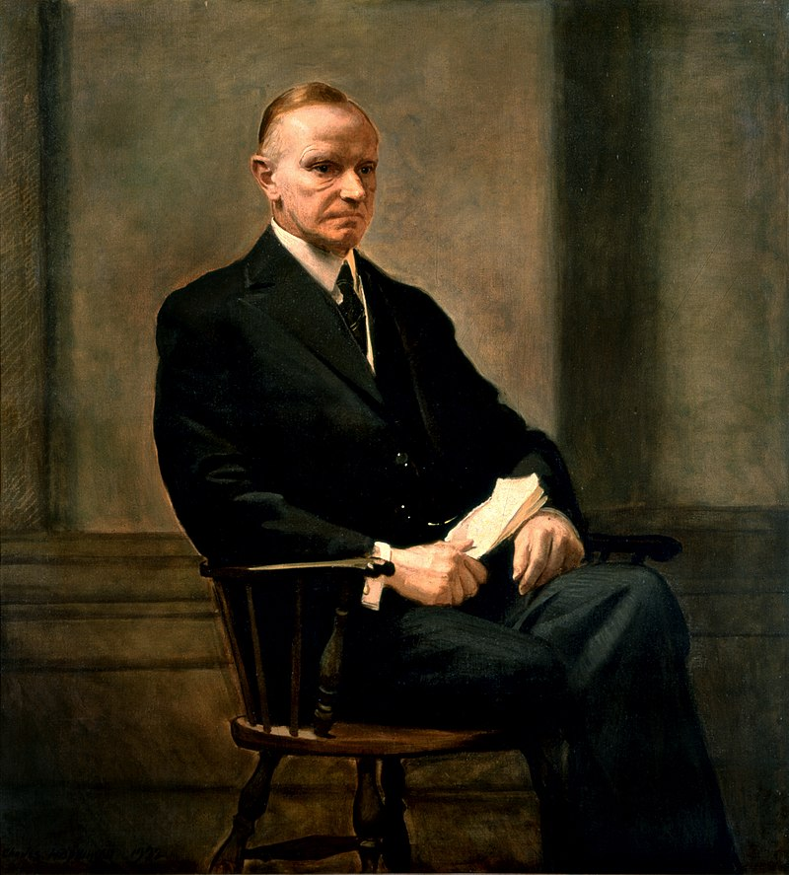
D. Persistence – another Great Attitude!:
4 - SUCCESSFUL ATTITUDES OF LIFE
Press On!
“Nothing in this world can take the place of PERSISTENCE.
Talent will not; Nothing is more common than unsuccessful men with talent.
Genius will not; unrewarded genius is almost a proverb.
Education will not; the world is full of educated derelicts.
Persistence and determination alone are omnipotent. The Slogan “Press On” Has Solved And Always Will Solve The Problems Of The Human Race.”
‘Persistence’ by Calvin Coolidge
22nd President of the United States

Slide 18
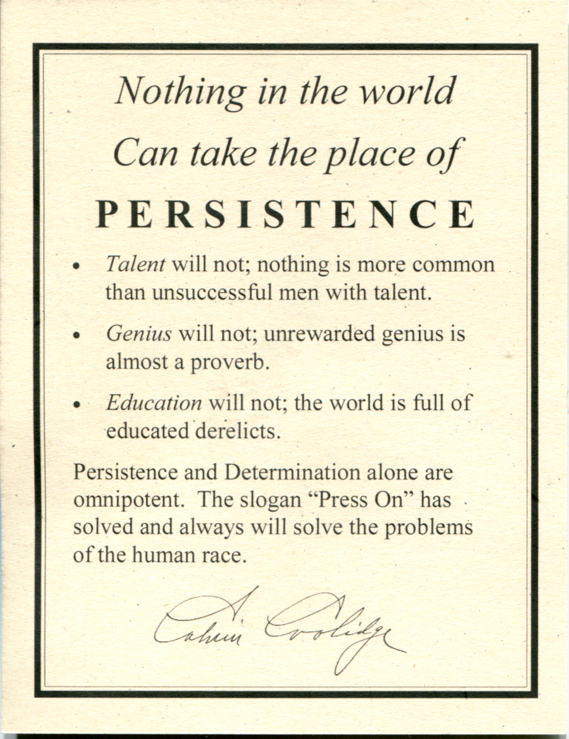
D. Persistence – another Great Attitude!:
4 - SUCCESSFUL ATTITUDES OF LIFE

Slide 19
E. How Do Successful People Get That Way:
4 - SUCCESSFUL ATTITUDES OF LIFE
1. THEY HAVE PLENTY OF DRIVE.
2. THEY ACCEPT RESPONSIBILITY CHEERFULLY.
3. THEY KNOW THAT SUCCESS IS NEVER AN ACCIDENT.
4. THEY KNOW THAT THE CUSTOMER IS THEIR REAL “BOSS”.
5. THEY LOOK – LISTEN – AND LEARN.

Slide 20
E. How Do Successful People Get That Way:
4 - SUCCESSFUL ATTITUDES OF LIFE
6. THEY FIND OUT – IF THEY’RE NOT SURE.
7. THEY SET AN EXAMPLE TO OTHERS.
8. THEY KNOW THAT THE NEXT FIELD ONLY “LOOKS” GREENER.
9. THEY WELCOME NEW IDEAS.
10. THEY PROFIT BY THEIR MISTAKES.

Slide 21
E. How Do Successful People Get That Way:
4 - SUCCESSFUL ATTITUDES OF LIFE
11. THEY SPEAK CLEARLY AND CONVINCINGLY.
12. THEY DON’T EXECT ALL THE CREDIT.
13. THEY COOPERATE.
14. THEY REALIZE THAT THEIR POWER IS THEIR OWN RESPONSIBILITY.
15. THEY THINK THINGS THROUGH -- FIRST.

Slide 22
E. How Do Successful People Get That Way:
4 - SUCCESSFUL ATTITUDES OF LIFE
16. THEY BELIEVE THAT GOOD MANNERS ARE GOOD BUSINESS.
17. THEY KNOW THE WORLD DOES NOT OWE THEM A LIVING.
18. THEY ARE WILLING TO GO THAT “EXTRA” MILE.
19. THEY SET GOALS FOR THEMSELVES.
20. THEY REALIZE THAT EVEYTHING WORTH HAVING HAS A PRICE TAG.

Slide 23
E. How Do Successful People Get That Way:
4 - SUCCESSFUL ATTITUDES OF LIFE
21. THEY KEEP PHYSICALLY AND MENTALLY FIT.
22. THEY EARNESTLY WANT TO SUCCEED.
23. THEY KNOW THE VALUE OF ENTHUSIASM.
24. THEY MAKE OTHERS FEEL IMPORTANT.
25. THEY TRY TO HELP THE “BOSS.”

Slide 24
E. How Do Successful People Get That Way:
4 - SUCCESSFUL ATTITUDES OF LIFE
26. THEY NEVER “PASS THE BUCK.” (‘NO EXCUSE SIR!”)
27. THEY CONTROL THEIR TEMPER.
28. THEY CONSIDER WORK A PRIVILEDGE, NOT A CHORE.
29. THEY ARE THEIR OWN CRITIC.
30. THEY’VE LEARNED THAT EASY DOES IT.

Slide 25
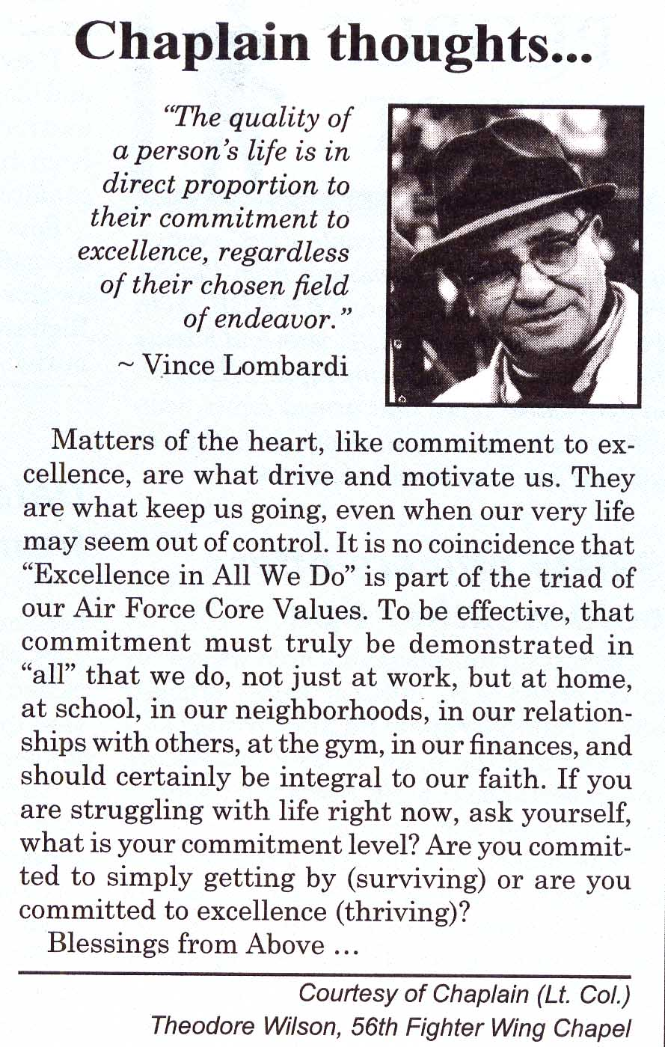
E. How Do Successful People Get That Way:
4 - SUCCESSFUL ATTITUDES OF LIFE
31. THEY TRY TO CUT EXPENSES.
32. THEY NEVER FORGET – that “good enough” is not enough today – or any day – and that only our BEST will pass the test.

Slide 26
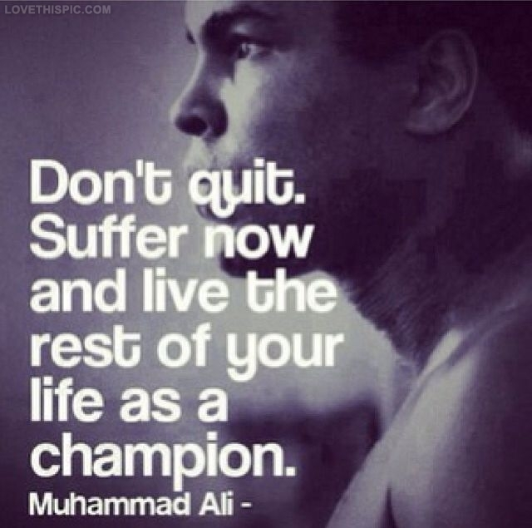
F. Don’t Quit!:
4 - SUCCESSFUL ATTITUDES OF LIFE
When things go wrong as they sometimes will,
When the road you’re trudging seems all uphill,
When the funds are low and the debts are high,
And you want to smile, but you have to sigh,
When care is pressing you down a bit –
Rest if you must, but don’t you quit.
Life is queer with its twists and turns,
As every one of us sometimes learns,
And many a fellow turns about
When he might have won had he stuck it out.
Don’t give up though the pace seems slow –
You may succeed with another blow.
Often the goal is nearer than
It seems to a faint and faltering man;
Often the struggler has given up
When he might have captured the victor’s cup;
And he learned too late when the night came down,
How close he was to the golden crown.
Success is failure turned inside out –
The silver tint of clouds of doubt,
And you never can tell how close you are,
It may be near when it seems afar;
So stick to the fight when you’re hardest hit –
It’s when things seem worst that you mustn’t quit.
>>> The hardest battle of life is the battle against ourselves.
>>> Win that battle and we are masters of all we survey.
--- Author Anonymous
THE POEM - DON’T QUIT !

Slide 27
G. Other Successful Attitudes
4 - SUCCESSFUL ATTITUDES OF LIFE
“To succeed YOU must be willing to pay the price.”
From: W. Clement Stone, author of “Positive Mental Attitude” & “The Art of Motivation”
In his writings Dr. Napoleon Hill listed the following “17 principles of Success”:
1. Positive Mental Attitude
2. Definiteness of Purpose
3. Going the Extra Mile
Accurate Thinking
Self-Discipline
Master-mind Alliance
Applied Faith
8. Pleasing Personality
9. Personal Initiative
10. Enthusiasm
Controlled Attention
Teamwork
Learning from Defeat
Creative Vision
Budgeting Time and Money
16. Maintaining Sound Physical & Mental Health
17. Using Cosmic Habit Force

Slide 28
CLASS SUMMARY
4 - SUCCESSFUL ATTITUDES OF LIFE
WHAT WAS TAUGHT - SUMMARY?
___________________________________________________________
_______________________________________________________________
WHAT WAS LEARNED?
___________________________________________________________
_______________________________________________________________
WHAT DID YOU DISCOVER YOU DIDN’T KNOW BEFORE?
___________________________________________________________
_______________________________________________________________

Slide 29
4 – SUCCESSFUL ATTITUDES OF LIFE
END OF:
PERSONAL DEVELOPMENT-I
Part 4- Successful Attitudes of Life

