Slide 1
OFFICER CANDIDATE SCHOOL
WK: USAF ORGANIZATION & STRUCTURE
Reference: Air Force Fact Sheets , AF Magazine (Almanac Issue), Airman Magazine (The Book), USAFX Warrior Handbook

Slide 2
OFFICER CANDIDATE SCHOOL USAF ORGANIZATION & STRUCTURE
COURSE TOPICS
Section 1: CREATION OF THE AIR FORCE
Section 2: AIR FORCE SHIELD
Section 3: USAF CHIEF OF STAFFS
Section 4: STRUCTURE OF THE AIR FORCE
Section 5: AIR FORCE 12 CORE FUNCTIONS
Section 6: AIR FORCE MAJOR COMMANDS
Section 7: INFORMATION SOURCES

Slide 3
USAF ORGANIZATION & STRUCTURE
Sec 1: CREATION OF THE A.F.

Slide 4
USAF ORGANIZATION & STRUCTURE
Sec. 1 – Creation of the Air Force
Creating the Air Force - Historical Facts:
World War II had been over for two years.
3 Years before Korean War.
Air Force’s 40-Year association with Army
ended.
Air Force became Separate Service.
Air Force was created as separate
Department.

Slide 5
USAF ORGANIZATION & STRUCTURE
Sec. 1 – Creation of the Air Force
Creating the Air Force - Historical Facts:
President Harry S. Truman signed: The National Security Act of 1947
Effective date: September 18, 1947
US Supreme Court Chief Justice Fred M. Vinson administered the oath of office to: The first Secretary of the Air Force (W. Stuart Symington)
SAF position is filled by presidential appointment.

Slide 6
USAF ORGANIZATION & STRUCTURE
Sec. 1 – Creation of the Air Force
Creating the Air Force - Historical Facts:
Functions under Army Air Force commanding
general transferred to the Department of the Air
Force.
2-year transition period of: Property, Personnel,
and Records

Slide 7
USAF ORGANIZATION & STRUCTURE
Sec. 1 – Creation of the Air Force
DOD Reorganization Act of 1958:
Depts. of Army, Navy and Air Force eliminated
from chain of operational command.
Commanders of unified and specified commands
became responsible to the president and the
secretary of defense through the Joint Chiefs of
Staff.
Functions of military departments to those of:
Managing, organizing, training, equipping and
supporting combat forces for the unified and
specified commands.

Slide 8
USAF ORGANIZATION & STRUCTURE
Sec 2: THE AIR FORCE SHIELD

Slide 9
USAF ORGANIZATION & STRUCTURE
Sec. 2 – The Air Force Shield
Official Colors
Ultramarine blue and Air Force yellow appear predominantly on the Air Force Seal.
The circular background of the seal is ultramarine blue.
The trim is Air Force yellow.

Slide 10
USAF ORGANIZATION & STRUCTURE
Sec. 2 – The Air Force Shield
The Crest
Eagle - The American bald eagle symbolizes the United States and its air power and appears in its natural colors.
Wreath - The wreath under the eagle is made up of six alternate folds of metal - white (silver) and light blue.

Slide 11
USAF ORGANIZATION & STRUCTURE
Sec. 2 – The Air Force Shield
The Crest
Cloud Formations - The white clouds behind the eagle shows the start of a new sky - the Department of the Air Force.

Slide 12
USAF ORGANIZATION & STRUCTURE
Sec. 2 – The Air Force Shield
The Shield
… below the eagle, is divided into two parts by a nebulous line representing clouds.
Top part bears an Air Force yellow thunder-both with flames in natural colors that show striking power through the use of aerospace.
The stars represent the original 13 colonies.
The yellow Roman numerals represent 1947, the year the Air Force was established.

Slide 13
USAF ORGANIZATION & STRUCTURE
Sec 3: USAF CHIEFS OF STAFF

Slide 14
USAF ORGANIZATION & STRUCTURE
Sec. 3 – USAF Chief of Staffs
INTRO…
The list depicts only the USAF Chief of Staff after the National Security Act of 1947.
Before 1947, the Army had control of the Air Corps, and Air Service.
These air arms had different leaders; some examples include:
Maj. Gen. Foulois
Gen. Henry H. Arnold
Gen. Carl A. Spaatz

Slide 15
USAF ORGANIZATION & STRUCTURE
Sec. 3 – USAF Chief of Staffs
1. General Carl A. Spaatz Sep 47 - Apr 48
2. General Hoyt S. Vandenberg Apr 48 - Jun 53
3. General Nathan F. Twining Jun 53 - Jun 57
4. General Thomas D. White Jul 57 - Jun 61
5. General Curtis E. LeMay Jun 61 - Jan 65
6. General John P. McConnell Feb 65 - Jul 69
7. General John D. Ryan Aug 69 - Jul 73
8. General George S. Brown Aug 73 - Jun 74
9. General David C. Jones Jul 74 - Jun 78

Slide 16
USAF ORGANIZATION & STRUCTURE
Sec. 3 – USAF Chief of Staffs
10. General John D. Ryan Aug 69 - Jul 73
11. General George S. Brown Aug 73 - Jun 74
12. General David C. Jones Jul 74 - Jun 78
13. General Lew Allen, Jr. Jul 78 - Jun 82
14. General Charles D. Gabriel Jul 82 - Jun 86
15. General Larry D. Welch Jul 86 - Jun 90
16. General Michael J. Dugan Jul 90 - Sep 90
17. General John M. Loh (acting) Sep 90 - Oct 90
18. General Merrill A. McPeak Oct 90 - Oct 94

Slide 17
USAF ORGANIZATION & STRUCTURE
Sec. 3 – USAF Chief of Staffs
General Ronald R. Fogleman Oct 94 - Sep 97
19. General Ralph E. Eberhart (acting) Sep 97 - Oct 97
20. General Michael E. Ryan Oct 97 - Sep 01
21. General John P. Jumper Sep 01 - Sep 05
22. General T. Michael Mosley Sep 05 - Jul 08
23. General Duncan J. McNabb (acting)Jul 08 - Aug 08
24. General Norton A Schwartz Aug 08 - Aug 12
25. General Mark A. Welsh III Aug 12 -

Slide 18
USAF ORGANIZATION & STRUCTURE
Sec 4: STRUCTURE OF THE AIR FORCE

Slide 19
USAF ORGANIZATION & STRUCTURE
Sec. 4 – Structure of the Air Force
Below is the Organization Chart format variation in how the major
commands and subordinate units of the Air Force are organized:
DEPARTMENT OF DEFENSE
Cabinet Level headed by:
Secretary of Defense (SECDEF)
JOINT CHIEFS OF STAFF
Corporate Military Leadership by:
Chairman of Joints Chief of Staff (JCS)
Vice Chairman of Joint Chiefs of Staff

Slide 20
USAF ORGANIZATION & STRUCTURE
Sec. 4 – Structure of the Air Force
Below is the Organization Chart format variation in how the major commands and subordinate units of the Air Force are organized:
DEPARTMENT OF THE AIR FORCE
Air Force Leadership by:
Secretary of the Air Force (SAF)
Civilian Secretariat Staff
Chief of Staff, USAF – Military
MAJOR COMMANDS OF THE AIR FORCE
Air Force Major Command Leadership by:
Commander – Major Command
NUMBERED AIR FORCES
Numbered Air Force Leadership by:
Commander – Numbered Air Force

Slide 21
USAF ORGANIZATION & STRUCTURE
Sec. 4 – Structure of the Air Force
Below is the Organization Chart format variation in how the major commands and subordinate units of the Air Force are organized:
WING Fundamental Working Unit
Commander – Wing
GROUP Objective Wing (only)
Commander – Group
Operations Maintenance Support Medical
SQUADRON
Commander – Squadron
Flight Commander -- Flights (Several)

Slide 22
USAF ORGANIZATION & STRUCTURE
Sec 5: AIR FORCE 12-CORE FUNCTIONS

Slide 23
USAF ORGANIZATION & STRUCTURE
Sec. 5 – Air Force 12 Core Functions
NUCLEAR DETERENCE OPERATIONS
AIR SUPERIORITY
3. SPACE SUPERIORITY
4. CYBERSPACE SUPERIORITY
5. GLOBAL PRECISION
ATTACK
6. RAPID GLOBAL MOBILITY
SPECIAL OPERATIONS
GLOBAL INTEGRATED ISR
COMMAND AND CONTROL
PERSONAL RECOVERY
BUILDING PARTNERSHIPS
12. AGILE COMBAT SUPPORT

Slide 24
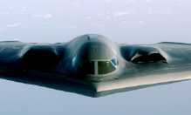
USAF ORGANIZATION & STRUCTURE
Sec. 5 – Air Force 12 Core Functions
NUCLEAR DETERENCE OPERATIONS
Objectives:
To operate with a re-emphasis
in accountability, compliance,
and precision in the nuclear
enterprise.

Slide 25
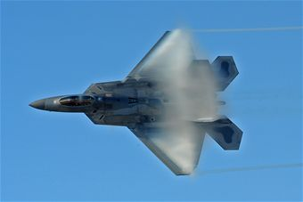
USAF ORGANIZATION & STRUCTURE
Sec. 5 – Air Force 12 Core Functions
2. AIR SUPERIORITY
Means…
… that Air Superiority and Global Precision Attack remain the foundations of our ability to deliver Global Power.

Slide 26
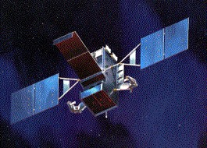
USAF ORGANIZATION & STRUCTURE
Sec. 5 – Air Force 12 Core Functions
3. SPACE SUPERIORITY
Means…
Having the ability to operate effectively across the spectrum of conflict is enabled by our space capabilities..

Slide 27
USAF ORGANIZATION & STRUCTURE
Sec. 5 – Air Force 12 Core Functions
CYBERSPACE SUPERIORITY
Means…
-The ability to operate within the cyber domain for our networked force
-Develop the necessary capabilities
- Defend the cyber domain.

Slide 28
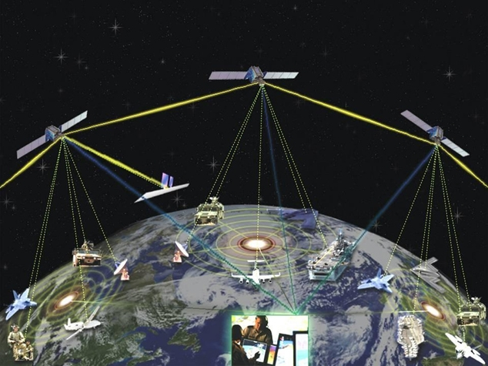
USAF ORGANIZATION & STRUCTURE
Sec. 5 – Air Force 12 Core Functions
5. GLOBAL PRECISION
ATTACK
Means…
the ability to hold any
target at risk, across the air, land, and sea domains.

Slide 29
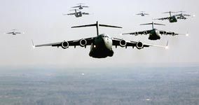
USAF ORGANIZATION & STRUCTURE
Sec. 5 – Air Force 12 Core Functions
6. RAPID GLOBAL MOBILITY
Means…
The ability of mobility forces provide:
An essential deployment and sustainment capability for the Joint force
Delivering personnel, equipment, and supplies necessary for missions ranging from conflict to humanitarian relief.

Slide 30
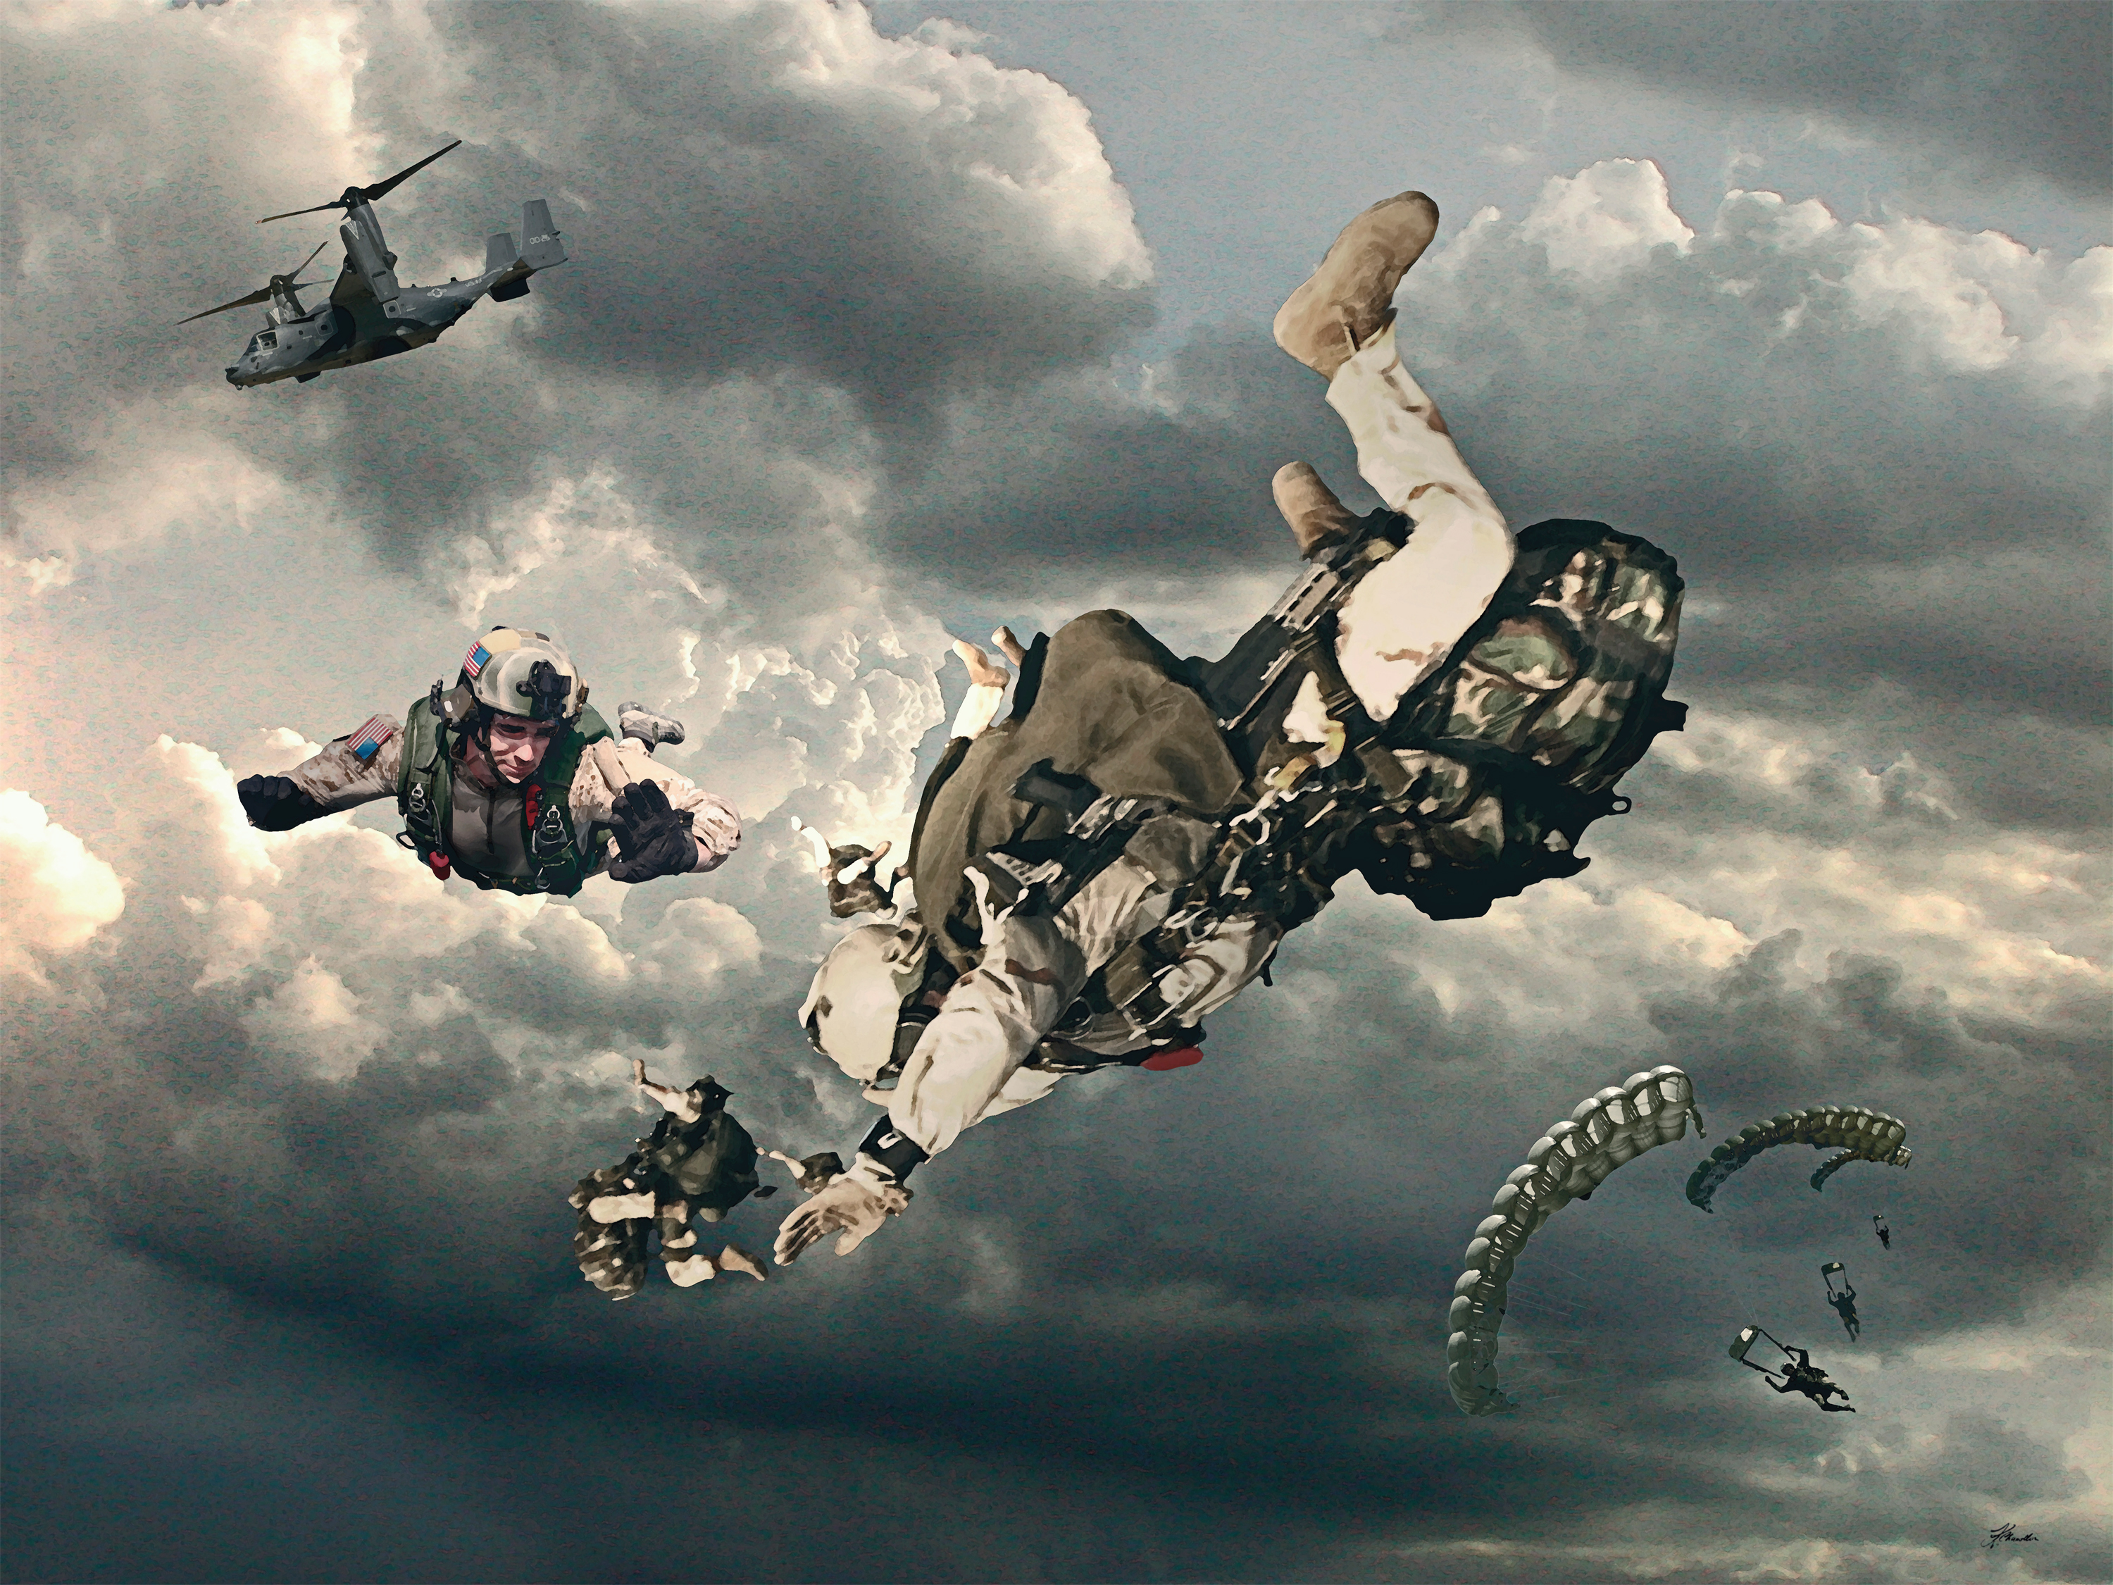
USAF ORGANIZATION & STRUCTURE
Sec. 5 – Air Force 12 Core Functions
7. SPECIAL OPERATIONS
Objectives:
To respond to growth in the requirements for Irregular Warfare (IW) and the role special operations forces play in today’s fight, such as:
- special operations airlift,
close air support
foreign internal defense
intelligence, surveillance, &
reconnaissance capabilities.

Slide 31
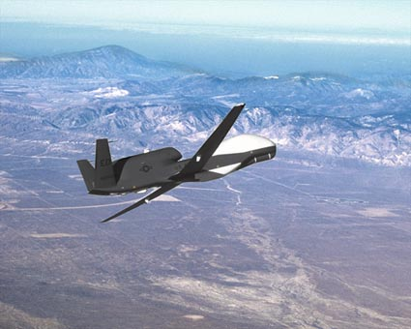
USAF ORGANIZATION & STRUCTURE
Sec. 5 – Air Force 12 Core Functions
8. GLOBAL INTEGRATED ISR
Means:
The ability to provide timely, fused, and actionable intelligence to the Joint force, from forward deployed locations and globally distributed centers around the globe.

Slide 32
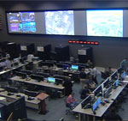
USAF ORGANIZATION & STRUCTURE
Sec. 5 – Air Force 12 Core Functions
9. COMMAND AND CONTROL
Means…
The ability to enable efficient and effective exploitation of the air, space, and cyber domain
…for Theater-wide command and control (C2) at the tactical, operational, and strategic levels.

Slide 33
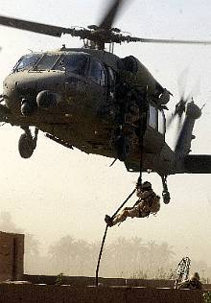
USAF ORGANIZATION & STRUCTURE
Sec. 5 – Air Force 12 Core Functions
10. PERSONAL RECOVERY
Means…
The ability to increase utilization and support of
Personnel Recovery (PR) forces missions in support of Overseas Contingency Operations.

Slide 34
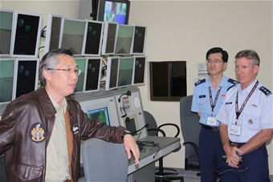
USAF ORGANIZATION & STRUCTURE
Sec. 5 – Air Force 12 Core Functions
BUILDING
PARTNERSHIPS
Means…
The ability to seek opportunities to develop partnerships around the world, and to enhance long-term capabilities through security cooperation.

Slide 35
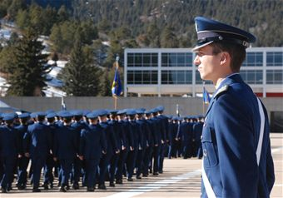
USAF ORGANIZATION & STRUCTURE
Sec. 5 – Air Force 12 Core Functions
12. AGILE COMBAT
SUPPORT
Means...
To effectively increase the development and training of Airmen and to revitalize processes for more effective installation support, logistics, and acquisition.

Slide 36
USAF ORGANIZATION & STRUCTURE
Sec 6: AIR FORCE MAJOR COMMANDS

Slide 37
USAF ORGANIZATION & STRUCTURE
Sec. 6 – Air Force Major Commands
11 MAJOR COMMANDS OF THE USAF
1. AIR COMBAT COMMAND (ACC)
2. AIR EDUCATION COMMAND (AETC)
3. AIR FORCE GLOBAL STRIKE COMMAND (AFGSC)
4. AIR FORCE MATERIAL COMMAND (AFMC)
5. AIR FORCE RESERVE COMMAND (AFRC)

Slide 38
USAF ORGANIZATION & STRUCTURE
Sec. 6 – Air Force Major Commands
11 MAJOR COMMANDS OF THE USAF
6. AIR FORCE SPACE COMMAND (AFSPC)
7. AIR FORCE SPECIAL OPERATIONS COMMAND (AFSOC)
8. AIR MOBILITY COMMAND (AMC)
9. AIR NATIONAL GUARD (ANG)
10. PACIFIC AIR FORCES (PACAF)
11. US AIR FORCES EUROPE (USAFE)

Slide 39
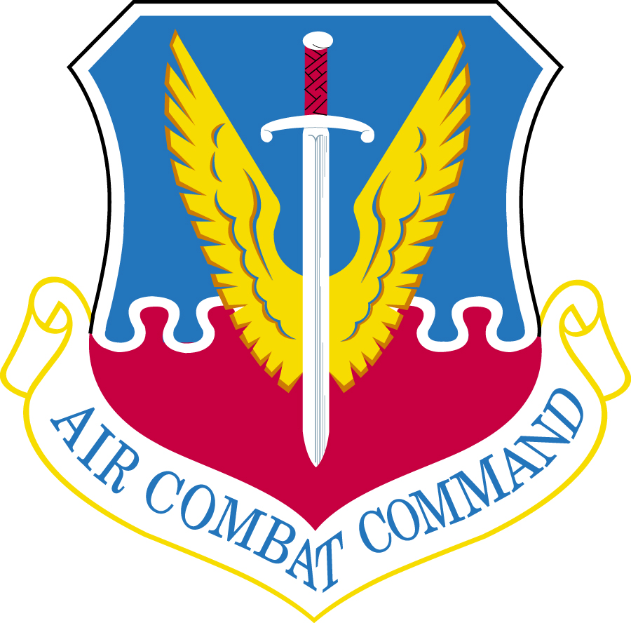
USAF ORGANIZATION & STRUCTURE
Sec. 6 – Air Force Major Commands
AIR COMBAT COMMAND (ACC) Langley AFB, Virginia
1st Air Force – Tyndall AFB, FL
9th Air Force – Shaw AFB, SC
12th Air Force – Davis Monthan AFB, AZ
25th Air Force – JB San Antonio-Randolph, TX

Slide 40
USAF ORGANIZATION & STRUCTURE
Sec. 6 – Air Force Major Commands
AIR COMBAT COMMAND
Primary Mission:
To Aim High...fly, fight, win... integrating capabilities across air, space and cyberspace to deliver precise, coercive effects in defense of our nation and its global interests.
Est: June 1, 1992
Primary Units:
1st Air Force – Tyndall AFB, FL
9th Air Force – Shaw AFB, SC
12th Air Force – Davis-Monthan AFB, AZ
25th Air Force – JB San Antonio-Randolph, TX
USAF Warfare Center – Nellis AFB, NV

Slide 41
USAF ORGANIZATION & STRUCTURE
Sec. 6 – Air Force Major Commands
AIR COMBAT COMMAND
ACC Responsibilities:
Lead command for the combat Air Force.
Organizes, trains, equips and deploys combat ready forces to support combatant commanders around the globe.
Provides the air component HQs to U.S. Northern, Southern and Central commands
Supports the in-place air components of U.S. European and Pacific commands.
Provides air defense forces to North American Aerospace Defense Command (NORAD).

Slide 42
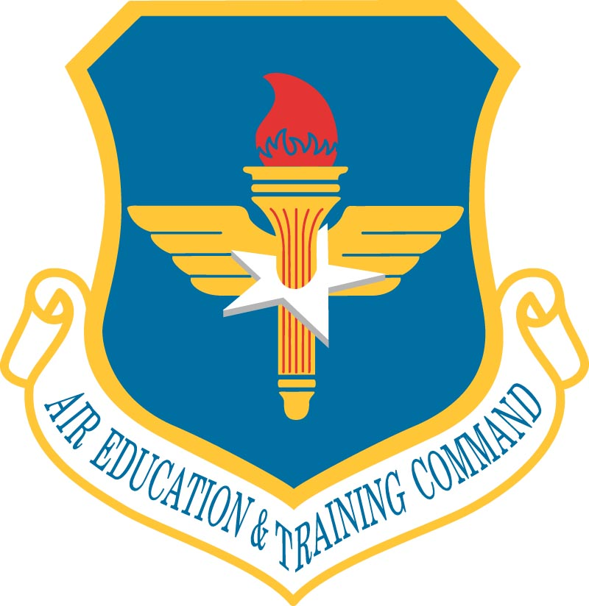
USAF ORGANIZATION & STRUCTURE
Sec. 6 – Air Force Major Commands
AIR EDUCATION & TRAINING COMMAND (AETC) Randolph AFB, Texas
2nd Air Force – Kessler AFB, MS
19th Air Force – JB San Antonio-Randolph, Texas

Slide 43
USAF ORGANIZATION & STRUCTURE
Sec. 6 – Air Force Major Commands
AIR EDUCATION & TRAINING COMMAND
Primary Mission:
Develops America’s Airmen today, for tomorrow. With a vision to deliver unrivaled air, space and cyberspace education and training, the command recruits Airmen and provides:
Basic military training
Initial and advanced technical training
Flying training
Medical training
Space and missile training
Cyber training
Professional military and degree-granting professional education.
The command also conducts joint, readiness and Air Force security assistance training.
Est: June 1, 1993
Primary Units:
2nd Air Force – Kessler AFB, MS
(Technical Training)
19th Air Force – JB SA-Randolph, TX
Air University – Maxwell AFB, AL

Slide 44
USAF ORGANIZATION & STRUCTURE
Sec. 6 – Air Force Major Commands
AIR EDUCATION & TRAINING COMMAND
AETC Responsibilities:
Sustains the combat capability of the operational Air Force with highly-trained and motivated Airmen.
Recalls individual ready reservists
Manages mobility and contingency tasking support for combatant commanders.

Slide 45
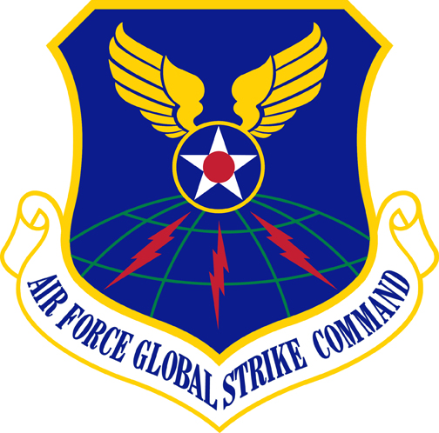
USAF ORGANIZATION & STRUCTURE
Sec. 6 – Air Force Major Commands
AIR FORCE GLOBAL STRIKE COMMAND (AFGSC) Barksdale AFB, Louisiana
8th Air Force – Barksdale AFB, LA
20th Air Force – F.E. Warren AFB, WY

Slide 46
USAF ORGANIZATION & STRUCTURE
Sec. 6 – Air Force Major Commands
AIR FORCE GLOBAL STRIKE COMMAND
Primary Mission:
Develop and provide combat-ready forces for nuclear deterrence and global strike operations — safe — secure — effective to support the President of the United States and combatant commanders.
Est: August 7, 2009
Primary Units:
8th Air Force – Barksdale AFB, LA
20th Air Force – F.E. Warren AFB, WY
576th Flight Test Sq. – Vandenburg AFB, CA
625th Strategic Operations Sq. – Offutt AFB, NE

Slide 47
USAF ORGANIZATION & STRUCTURE
Sec. 6 – Air Force Major Commands
AIR FORCE GLOBAL STRIKE COMMAND
AFGSC Responsibilities:
Organize, train and equip the Air Force’s three intercontinental ballistic missile wings, two B-52 Stratofortress wings and the only B-2 Spirit wing. The three weapons systems make up two-thirds of the nation’s strategic nuclear triad by providing the land-based and airborne nuclear deterrent forces.
Maintain and operate the Air Force's ICBM force.
Provides on-alert, combat-ready ICBMs to the President.

Slide 48
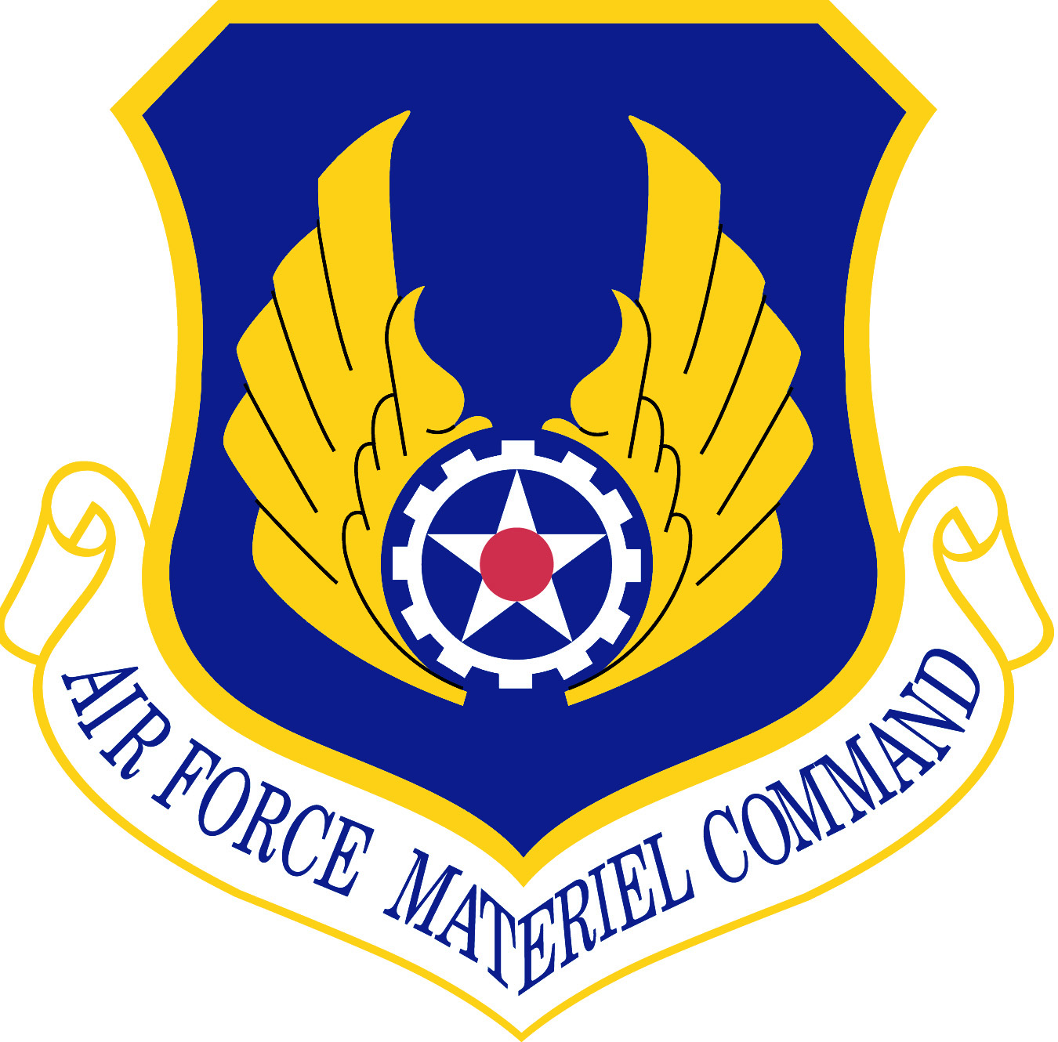
USAF ORGANIZATION & STRUCTURE
Sec. 6 – Air Force Major Commands
AIR FORCE MATERIAL COMMAND (AFMC)
Wright-Patterson AFB, Ohio

Slide 49
USAF ORGANIZATION & STRUCTURE
Sec. 6 – Air Force Major Commands
AIR FORCE MATERIAL COMMAND
Est: July 1, 1992
Primary Units:
Aeronautical Systems Center -- Wright-Patterson AFB,OH
Air Armament Center -- Eglin AFB, FL
Electronic Systems Center -- Hanscom AFB, MA
Air Force Flight Test Center -- Edwards AFB, CA
Arnold Engineering Development Ctr -- Arnold AFB, TN
AF Research Laboratory -- Wright-Patterson AFB, OH
Ogden Air Logistics Center -- Hill AFB, UT
Oklahoma City Air Logistics Center -- Tinker AFB, OK
Warner Robins Air Logistics Center -- Robins AFB, GA
AF Security Assistance Ctr -- Wright-Patterson AFB, OH
AF Global Logistics Support Center -- Scott AFB, Il
Air Force Nuclear Weapons Center -- Kirtland AFB, NM
309th Aerospace Maint & Regeneration Group --
Davis-Monthan AFB, AZ
National Museum – USAF -- Wright-Patterson AFB, OH
USAF Band of Flight -- Wright-Patterson AFB, OH
USAF Band of Liberty -- Hanscom AFB, MA
Primary Mission:
Delivers war-winning technology, acquisition support, sustainment and expeditionary capabilities to the warfighter.

Slide 50
USAF ORGANIZATION & STRUCTURE
Sec. 6 – Air Force Major Commands
AIR FORCE MATERIAL COMMAND
AFMC Responsibilities:
Conducts research, development and test and evaluation
Provides acquisition management services and logistics support necessary to keep Air Force weapon systems ready for war.

Slide 51
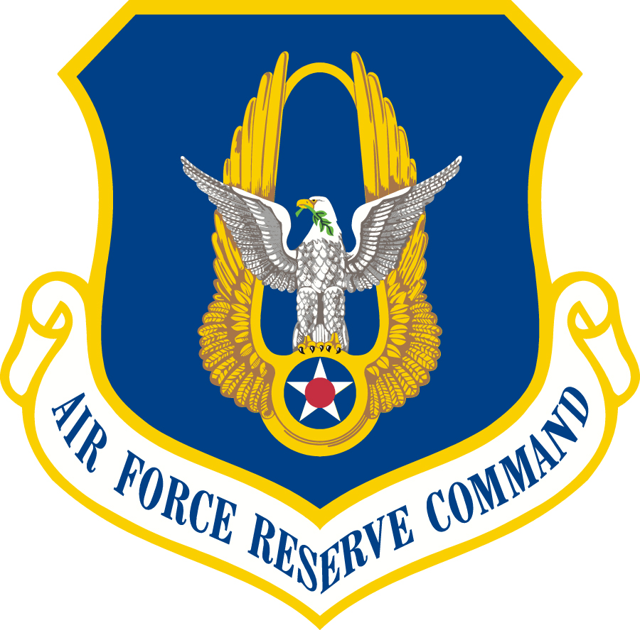
USAF ORGANIZATION & STRUCTURE
Sec. 6 – Air Force Major Commands
AIR FORCE RESERVE COMMAND (AFRC)
Robins AFB, Georgia
4th Air Force – March ARB, CA
10th Air Force – NAS JRB Fort Worth, TX
22nd Air Force – Dobbins AFB, GA

Slide 52
USAF ORGANIZATION & STRUCTURE
Sec. 6 – Air Force Major Commands
AIR FORCE RESERVE COMMAND
Primary Mission:
Provide combat ready forces to fly, fight and win.
Est: February 17, 1997
Primary Units:
4th Air Force – March ARB, CA
10th Air Force – NAS JRB Ft Worth, TX
22nd Air Force – Dobbins ARB, GA

Slide 53
USAF ORGANIZATION & STRUCTURE
Sec. 6 – Air Force Major Commands
AIR FORCE RESERVE COMMAND
AFRC Responsibilities:
Provides USAF about 14 % of the Total Force for about 4% of the manpower budget.
Reservists support nuclear deterrence operations, air, space and cyberspace superiority, command and control, global integrated intelligence surveillance reconnaissance, global precision attack, special operations, rapid global mobility and personnel recovery.
Perform space operations, aircraft flight testing, aerial port operations, civil engineer, security forces, military training, communications, mobility support, transportation and services missions.

Slide 54
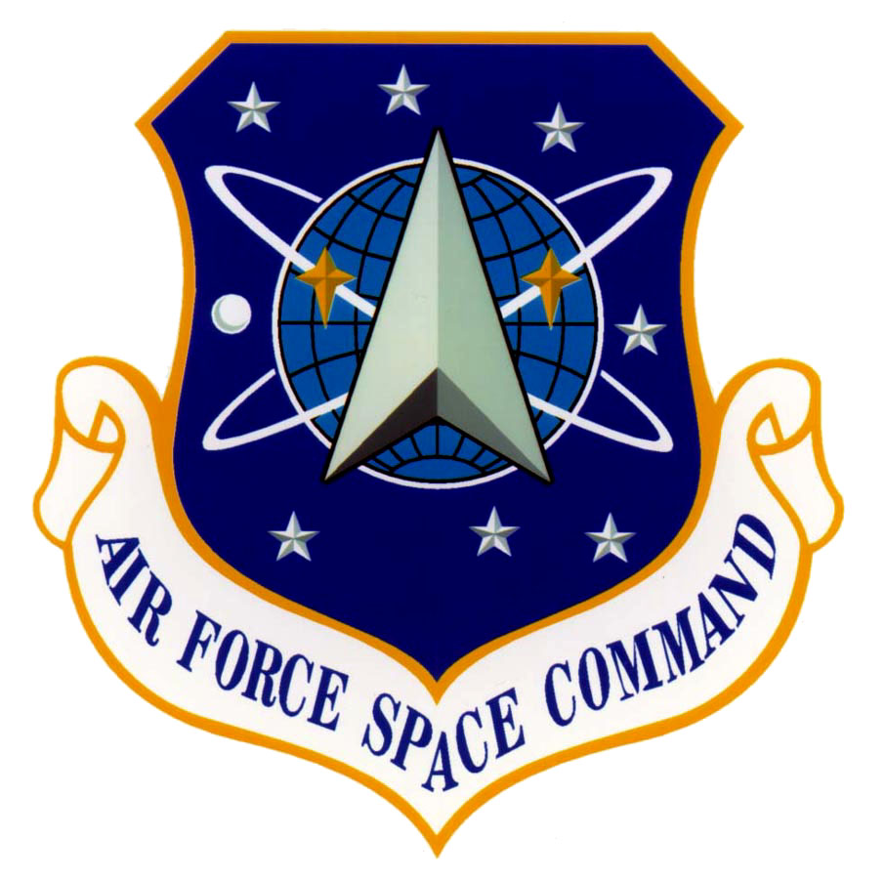
USAF ORGANIZATION & STRUCTURE
Sec. 6 – Air Force Major Commands
AIR FORCE SPACE COMMAND (AFSPC)
Peterson AFB, Colorado
24th Air Force – JB San Antonio-Lackland, TX

Slide 55
USAF ORGANIZATION & STRUCTURE
Sec. 6 – Air Force Major Commands
AIR FORCE SPACE COMMAND
Primary Mission:
Develops, acquires, fields, operates and sustains space systems and fields and sustains cyber systems.
Est: September 1, 1982
Primary Units:
24th AF - JB SA-Lackland AFB, TX

Slide 56
USAF ORGANIZATION & STRUCTURE
Sec. 6 – Air Force Major Commands
AIR FORCE SPACE COMMAND
AFSPC Responsibilities:
Organizes, trains and equips mission-ready space and cyberspace forces and capabilities for North American Aerospace Defense Command, U.S. Strategic Command and other combatant commands world-wide.
Oversees Air Force network operations to provide capabilities in, through and from cyberspace; manages a global network of satellites, and is responsible for space system development and acquisition.
Executes spacelift to launch satellites with a variety of expendable launch systems and operates them to provide space capabilities in support of combatant commanders around the clock.
It provides positioning, navigation, timing, communications, missile warning, weather and intelligence warfighting support.

Slide 57
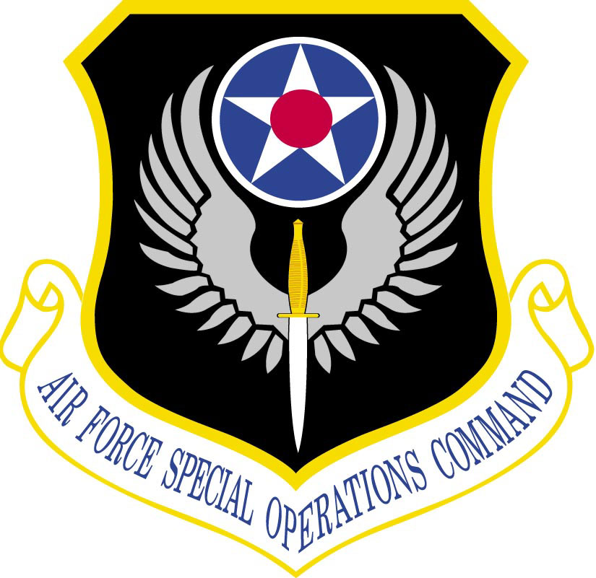
USAF ORGANIZATION & STRUCTURE
Sec. 6 – Air Force Major Commands
AIR FORCE SPECIAL OPERATIONS COMMAND (AFSOC)
Hurlburt Field, Florida

Slide 58
USAF ORGANIZATION & STRUCTURE
Sec. 6 – Air Force Major Commands
AIR FORCE SPECIAL OPERATIONS COMMAND
Primary Mission:
Air Force Special Operations Command is America’s specialized air power — a step ahead in a changing world, delivering special operations power anytime, anywhere.
Vision America's Air Commandos providing persistent, agile and responsive specialized airpower... Anytime... Anyplace
Est: May 22, 1990
No Primary Units

Slide 59
USAF ORGANIZATION & STRUCTURE
Sec. 6 – Air Force Major Commands
AIR FORCE SPECIAL OPERATIONS COMMAND
AFSOC Responsibilities:
Responsible to U.S. Special Operations Command for the readiness of Air Force special operations forces to conduct the war on terrorism and to disrupt, defeat and destroy terrorist networks that threaten the United States, its citizens and interests worldwide.
Capabilities include airborne radio and television broadcast for psychological operations, as well as aviation foreign internal defense instructors to provide other governments military expertise for their internal development. The command's special tactics squadrons combine combat controllers, special operations weathermen and pararescuemen with other service SOF to form versatile joint special operations teams.

Slide 60
USAF ORGANIZATION & STRUCTURE
Sec. 6 – Air Force Major Commands
AIR FORCE SPECIAL OPERATIONS COMMAND
AFSOC Responsibilities:
The command's core missions include battlefield air operations, agile combat support, aviation foreign internal defense, information operations/military support operations, precision strike, specialized air mobility; command and control; and intelligence, surveillance and reconnaissance; personnel and resources

Slide 61
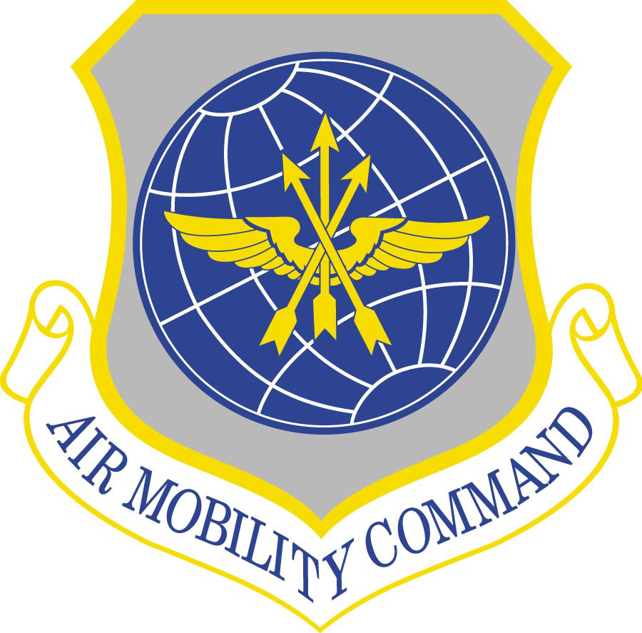
USAF ORGANIZATION & STRUCTURE
Sec. 6 – Air Force Major Commands
AIR MOBILITY COMMAND (AMC)
Scott AFB, Illinois
18th Air Force – Scott AFB, IL

Slide 62
USAF ORGANIZATION & STRUCTURE
Sec. 6 – Air Force Major Commands
AIR MOBILITY COMMAND
Primary Mission:
Provide global air mobility ... right effects, right place, right time.
Est: July 1, 1992
Primary Units:
18th Air Force – Scott AFB, IL
USAF Expeditionary Ctr – Little Rock AFB, AR
618th Air &Space Cmd Ctr – Scott AFB, IL

Slide 63
USAF ORGANIZATION & STRUCTURE
Sec. 6 – Air Force Major Commands
AIR MOBILITY COMMAND
AMC Responsibilities:
Provide airlift and aerial refueling for all of America’s armed forces, as well as refueling for some allied aircraft.
Provide aeromedical evacuation and Global Reach laydown.
With their many special-duty and operational support aircraft, AMC plays a crucial role in providing humanitarian support at home and around the world.
Provide the capability to deploy our armed forces anywhere in the world and help sustain them in a conflict.

Slide 64
USAF ORGANIZATION & STRUCTURE
Sec. 6 – Air Force Major Commands
PACIFIC AIR FORCES (PACAF)
Hickam AFB, Hawaii
5th Air Force – Yokota AB, Japan
7th Air Force – Osan AB, Korea
11th Air Force – JB Elmendorf-Richardson, Alaska

Slide 65
USAF ORGANIZATION & STRUCTURE
Sec. 6 – Air Force Major Commands
PACIFIC AIR FORCES
Primary Mission:
Provide: Pacific Command integrated expeditionary Air Force capabilities to defend the homeland, promote stability, dissuade/deter aggression, and swiftly defeat enemies.
Est: July 1, 1957
Primary Units:
5th Air Force – Yokota AB, Japan
7th Air Force – Osan AB, Korea
11th Air Force – JB Elmendorf-Richardson, Alaska

Slide 66
USAF ORGANIZATION & STRUCTURE
Sec. 6 – Air Force Major Commands
PACIFIC AIR FORCES
PACAF Responsibilities:
Organize, train, equip and maintain resources prepared to conduct a broad spectrum of air operations – from humanitarian relief to decisive combat employment — in the Department of Defense’s largest area of responsibility.
Conducts multinational exercises and hosts international exchange events to foster partnerships for regional security and stability in an area covering:
13 time zones
100 million square miles
with 60 percent of the world’s population
1/3 of the world’s economic activity
5 of the 6 largest armed forces.

Slide 67
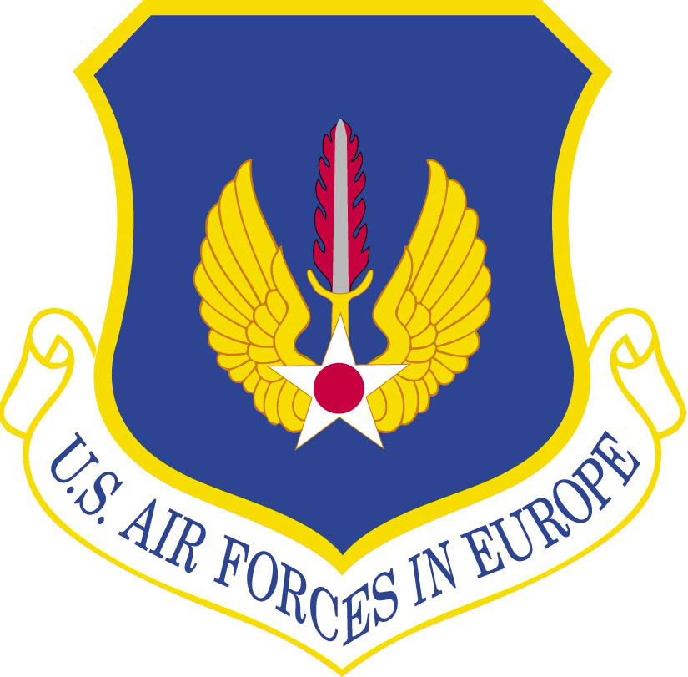
USAF ORGANIZATION & STRUCTURE
Sec. 6 – Air Force Major Commands
U.S. AIR FORCES IN EUROPE / AIR FORCES AFRICA (USAFE/AFAFRICA)
Ramstein AB, Germany

Slide 68
USAF ORGANIZATION & STRUCTURE
Sec. 6 – Air Force Major Commands
U.S. AIR FORCES IN EUROPE
Primary Mission:
Executes the U.S. European Command mission with forward-based air power to:
Provide forces for global operations
Ensure strategic access
Assure allies
Deter aggression
Build partnerships.
Est: August 7, 1945

Slide 69
USAF ORGANIZATION & STRUCTURE
Sec. 6 – Air Force Major Commands
U.S. AIR FORCES IN EUROPE
USAFE Responsibilities:
Build and maintain partnerships, promote regional stability, provide forces for global operations, support combatant command missions, develop and care for Airmen and their families, sustain forward-based infrastructure, ensure strategic access to U.S. forces, assure allies and deter aggression.
USAFE consists of:
7 main operating bases
114 geographically separated units.

Slide 70
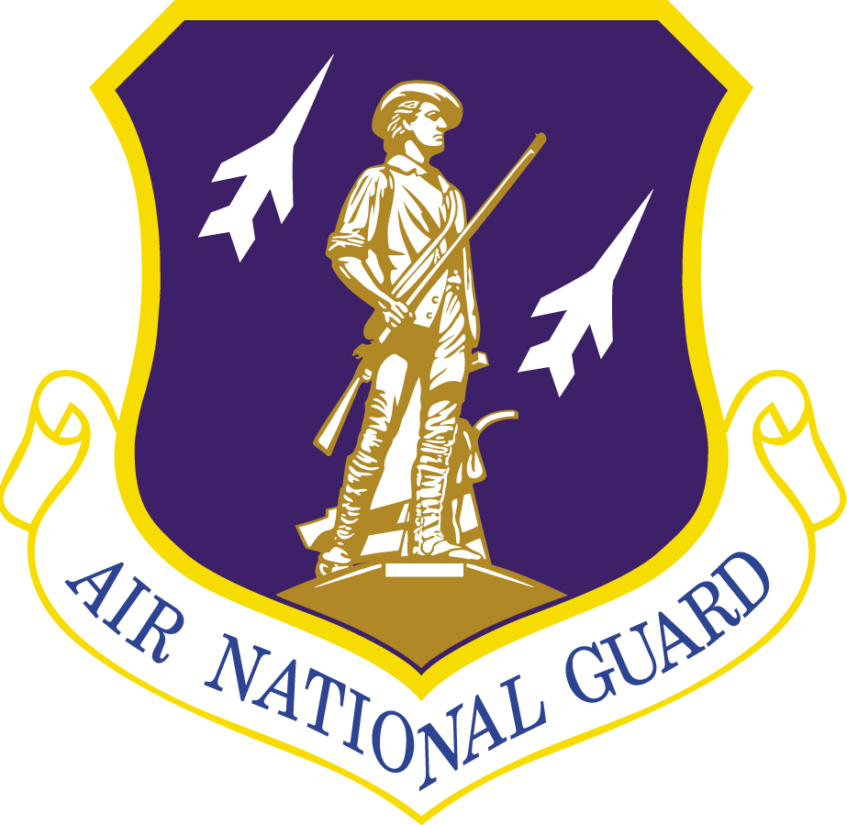
USAF ORGANIZATION & STRUCTURE
Sec. 6 – Air Force Major Commands
AIR NATIONAL GUARD (ANG)
Washington DC

Slide 71
USAF ORGANIZATION & STRUCTURE
Sec. 6 – Air Force Major Commands
AIR NATIONAL GUARD
Primary Mission:
The Air National Guard has both a federal and state mission.
The dual mission, a provision of the U. S. Constitution, results in each guardsman holding membership in the National Guard of his or her state and in the National Guard of the United States
Est: September 17, 1947
No Primary Units:

Slide 72
USAF ORGANIZATION & STRUCTURE
Sec. 6 – Air Force Major Commands
AIR NATIONAL GUARD
ANG Responsibilities – Federal Mission:
To maintain well-trained, well-equipped units available for prompt mobilization during war and provide assistance during national emergencies, such as natural disasters or civil disturbances.
During peace, the combat-ready units and support units are assigned to Air Force major commands to carry out missions compatible with training, mobilization readiness, humanitarian and contingency operations.

Slide 73
USAF ORGANIZATION & STRUCTURE
Sec. 6 – Air Force Major Commands
AIR NATIONAL GUARD
ANG Responsibilities – Federal Mission:
Air National Guard units may be activated in a number of ways as prescribed by public law. Most of the laws are found in Title 10 of the U.S. Code.
The ANG provides almost half of the Air Force’s tactical airlift support, combat communications functions, aeromedical evacuation and aerial refueling.
In addition, the ANG has total responsibility for air defense of the entire United States.

Slide 74
USAF ORGANIZATION & STRUCTURE
Sec. 6 – Air Force Major Commands
AIR NATIONAL GUARD
ANG Responsibilities – State Mission:
When ANG units are not mobilized or under federal control, they report to the governor of their respective state, territory or the commanding general of the District of Columbia National Guard.
Each are supervised by the adjutant general of a state or territory.
Under state law: provides protection of life, property and preserves peace, order and public safety.
These missions are accomplished through emergency relief support during natural disasters; search and rescue operations; support to civil defense authorities; maintenance of vital public services and counterdrug operations.

Slide 75
USAF ORGANIZATION & STRUCTURE
Sec. 6 – Air Force Major Commands
AIR NATIONAL GUARD
ANG Responsibilities – Flying Mission:
Provides:
100% of the interceptor
64% of the air traffic control
49% of the tactical airlift
45% of the KC-135 refueling capability
32 % of the general purpose fighter force
23% of the rescue and recovery capability
16% of tactical air support
15% percent of the weather flight
11% percent of the strategic airlift capability
6% of the Air Force’s special operations capability.

Slide 76
USAF ORGANIZATION & STRUCTURE
Sec. 6 – Air Force Major Commands
AIR NATIONAL GUARD
ANG Responsibilities – Support Activity:
Provides:
100% of the aircraft control and warning forces
80% of combat communication
74% percent of the installation engineering capability
68 % of the air control support forces
49% of the civil engineering forces
38% of the security forces
96% of the mobile airborne fire fighting system forces
14 % of aerial port operations capability.

Slide 77
USAF ORGANIZATION & STRUCTURE
Sec 7: INFORMATION SOURCES

Slide 78
USAF ORGANIZATION & STRUCTURE
Sec. 7 – Information Sources
The following are excellent Websites or Magazines on current Air Force Ops & Weapon Systems, etc:
WEB SITES:
Air Force Web Site: http://www.af.mil/
Military.com: http://www.military.com/
Global Security.org http://www.globalsecurity.org/ (Paid Subscript.)
NEWSPAPERS/MAGAZINES:
Air Force Magazine http://www.airforcemag.com/
Air Force Times http://www.airforcetimes.com/
NOTE: Numerous other sources are listed in the USAF Explorers Web Site IN THE “Library & Links” TAB
http://www.usafexplorers.org/

Slide 79
OFFICER CANDIDATE SCHOOL USAF ORGANIZATION & STRUCTURE
END of
USAF ORGANIZATION & STRUCTURE
… Take 5 Min. Break!

