Slide 1
PERSONAL DEVELOPMENT
COURSE
PART 6:
TIME MANAGEMENT
SKILLS

Slide 2
Class Subjects:
6 – TIME MANAGEMENT SKILLS
Importance of organizing your day
Utilizing a Day-Timer / Daily Organizer
Planning your: Year / Month / Week / Day
How your Goals fit into Day-to-Day Planning
Effective Scheduling Technique (‘Attachment’)
Avoiding Over-commitments
Prioritizing your Time
Scheduling your next Month
Keeping Study Area / Desk Space organized
Organization & Study tips
In Summary

Slide 3
6 – TIME MANAGEMENT SKILLS
Part A.
IMPORTANCE OF ORGANIZING YOUR DAY

Slide 4
6 – TIME MANAGEMENT SKILLS
Part A. IMPORTANCE OF ORGANIZING YOUR DAY
You planned your work (Goal Setting)…
… NOW WORK YOUR PLAN !
You set your goals: (Life-time > 5 Year Plan > 1 - 2 Yrs )
Now set up achieving them on a Monthly / Weekly / Daily basis.
Purpose of staying organized = “To simply accomplish what you said you wanted to do.”
Make it habit to plan your week: (Habit = 21 Days)
… HELPS AVOID TIME-WASTING HABITS.

Slide 5
6 – TIME MANAGEMENT SKILLS
Part B.
UTLIZING A DAY-TIMER /
DAILY ORGANIZER

Slide 6
A. Importance of Organizing your Day:
6 – TIME MANAGEMENT SKILLS
Part B. UTILIZING A DAY-TIMER / DAILY ORGANIZER
OPTIONS OF WHAT TO USE…
Use the one you get at school.
Purchase one at Office Supply store (doesn’t have to be expensive one).
Try to find one that uses a weekly schedule with times indicated past 5pm and evening hours.
Squadron has weekly sheets to use (copy 1 / per week).
What ever you are comfortable with, BUT USE SOMETHING!
USE IT EVERYDAY !
Try not to make any decision or go anywhere without referring to it. (In order to make it a habit)

Slide 7
6 – TIME MANAGEMENT SKILLS
Part C.
PLANING YOUR:
YEAR / MONTH / WEEK / DAY
PRACTICE SAMPLE WEEKLY PLANNER.
(Class Hand-out)

Slide 8
6 – TIME MANAGEMENT SKILLS
Part D.
HOW YOUR GOALS FIT INTO DAY-TO-DAY PLANNING

Slide 9
6 – TIME MANAGEMENT SKILLS
Part D. HOW GOALS FIT INTO DAY-TO-DAY PLANNING
Break down your 5 goals years to 1 year
Break down your 1 year goals to monthly/weekly
Break down your monthly or weekly to daily
MOST IMPORTANT HABIT TO MAKE:
Spend up to 30 Min. – 1 Hour a week (usually at end of week (Sat-Sun)
Review past weeks activities
Did you accomplish what you wanted? Ask yourself Why or Why Not?
Finish planning or reconfirming your schedule for next week.

Slide 10
6 – TIME MANAGEMENT SKILLS
Part E.
EFFECTIVE SCHEDULING TECHNIQUE
(‘Attachment’)

Slide 11
6 – TIME MANAGEMENT SKILLS
Part E.EFFECTIVE SCHEDULING TECHNIQUES
TIPS FOR SCHEDULING EFFECTIVELY:
It is best done on paper
Use a Weekly Planner
Type of form is a personal decision
Some may use a wall calendar (but you can’t take it with you.
Some use small notebook
Most schools give out planners (but lack some key time blocks to fill in)
BUT AGAIN… USE SOMETHING !

Slide 12
6 – TIME MANAGEMENT SKILLS
Part E.EFFECTIVE SCHEDULING TECHNIQUES
1. Block out a planning time each week + DO IT!
Also set aside each day for thinking, reflecting, planning
Organize your thoughts
Quiet time is OK and IS the best way.
2. Block out committed time first
School / work hours
Travel time & normal meals
3. Fill in goals to accomplish
Study time
Sports / After School activities / USAFX

Slide 13
6 – TIME MANAGEMENT SKILLS
Part E.EFFECTIVE SCHEDULING TECHNIQUES
4. Put deadlines on your schedules !
5. Be flexible in scheduling time
Life is full of surprises – be prepared to Overcome, Adapt, Improvise
Only way to deal with the unexpected is to budget time for it
Rule of Thumb = Multiple activity time X1.25
If things normally take 1 hour, put down 1 Hour, 15 Min.

Slide 14
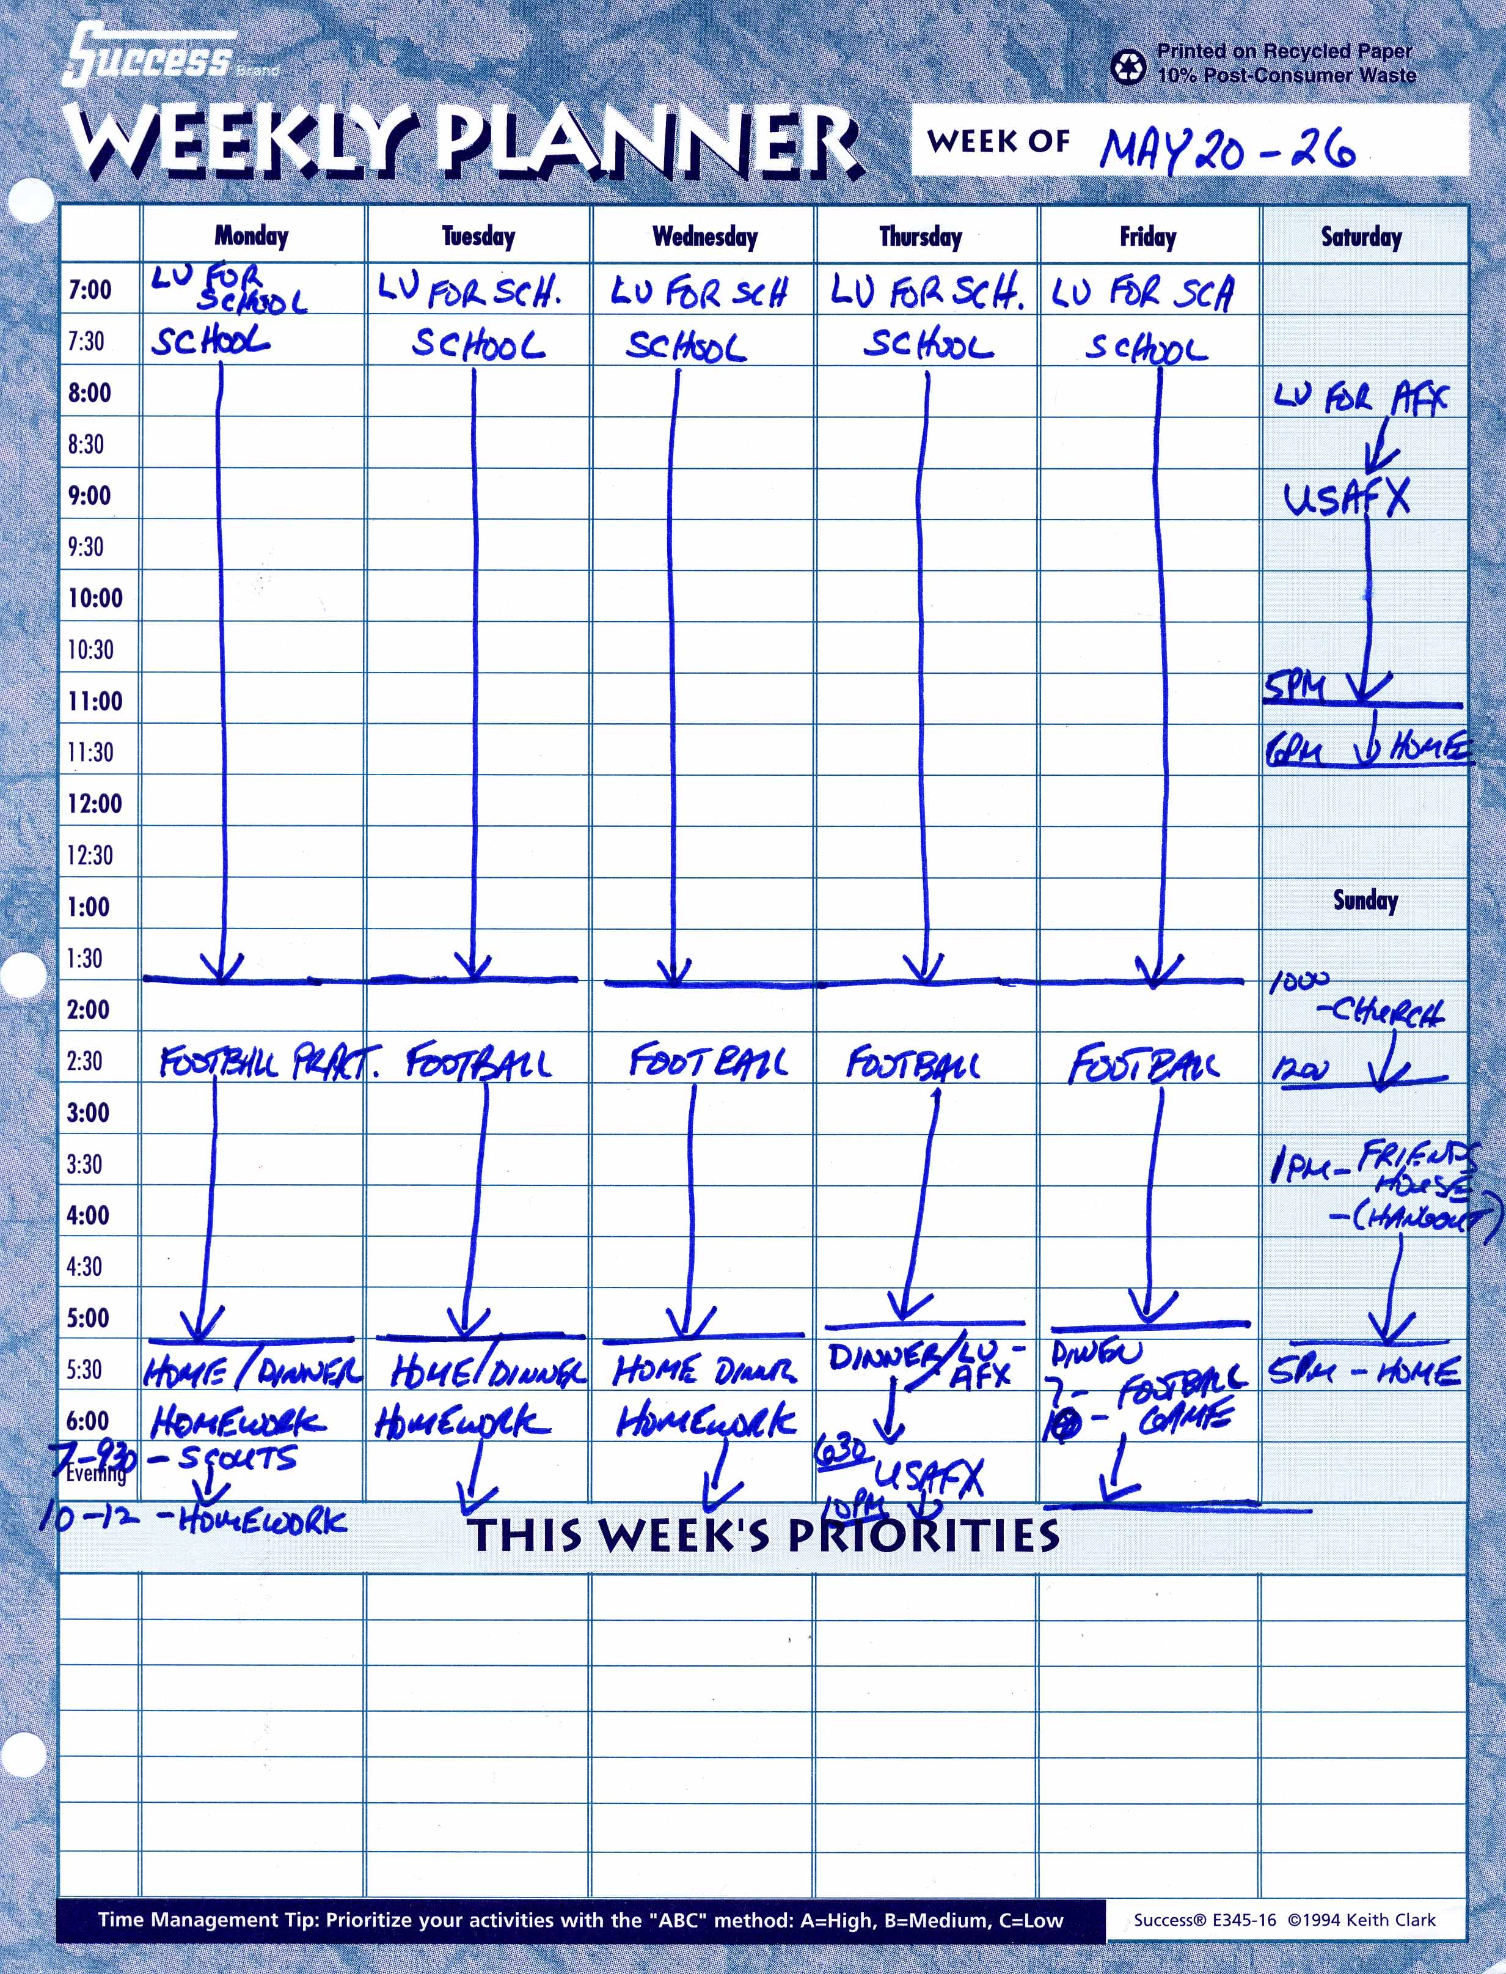

Slide 15
6 – TIME MANAGEMENT SKILLS
Part F.
AVOIDING OVER COMMITMENTS

Slide 16
6 – TIME MANAGEMENT SKILLS
Part F. OVOIDING OVER COMMITMENTS
Avoid over commitments
Learn to SAY NO
But be polite about it
Refuse requests that are not in your best interests.
School / Study time / Family / Work commitments come first.

Slide 17
6 – TIME MANAGEMENT SKILLS
Part F. OVOIDING OVER COMMITMENTS
Guidelines to “SAY NO”
Say no rapidly before people can anticipate that you may say yes.
“I don’t know” and “Let me think about it” only keeps peoples hopes up.
Realize that you have the right to say no.
You do not have to offer a reason every time you turn down someone’s request.
Offer your refusals politely and pleasantly.
Offer a counterproposal if you think it’s appropriate and the request is a valid one.
“I can’t get together on Saturday, but maybe for a couple hours on Sunday.”

Slide 18
6 – TIME MANAGEMENT SKILLS
Part G.
PRIORITIZING YOUR TIME

Slide 19
6 – TIME MANAGEMENT SKILLS
Part G.PRIOTITIZING YOUR TIME
Prioritizing your time
Make the most of your prime time
Utilize best time of the day when your energy is at its best.
Don’t schedule something in AM when your too tired and can’t think.
Those who are not too good in Math and are not early risers should not have a Math Class first thing in AM.
If you have to go to a Doctor’s appt, etc. make the most of your time, by:
Bringing a book and read
Work on your schedule, plans, goals book, etc
Self – improvement areas

Slide 20
6 – TIME MANAGEMENT SKILLS
Part H.
SCHEDULING YOUR NEXT MONTH

Slide 21
6 – TIME MANAGEMENT SKILLS
Part H. SCHEDULING YOUR NEXT MONTH (In Day-Timer)
Schedule your next month
Within the week before or sooner (if you can)
Work on next month’s schedule throughout the month before (but only if something is confirmed)
Make it another Habit.

Slide 22
6 – TIME MANAGEMENT SKILLS
Part I.
KEEPING STUDY AREA /
DESK SPACE ORGANIZED

Slide 23
6 – TIME MANAGEMENT SKILLS
Part I. KEEP STUDY AREA / DESK ORGANIZED
Organize your workspace
1. Location (Choose one that is conducive to performing the task)
Pick quiet, private, place for study with no distractions
2. Space (Make sure you have enough space to work)
3. Easy access to tools you use frequently (reference books, computer, desk supplies, etc)

Slide 24
6 – TIME MANAGEMENT SKILLS
Part I. KEEP STUDY AREA / DESK ORGANIZED
Organize your workspace (Cont.)
4. Comfort (Proper seating, ventilation, & lighting)
Chair should be comfortable, but not so you do not have to get up every ten minutes.
DO NOT USE BED (OR PRONE POSITION) FOR STUDY !
YOU’RE MIND WILL EVENTUALLY THINK IT IS TIME FOR SLEEP, INSTEAD OF TIME TO THINK.

Slide 25
6 – TIME MANAGEMENT SKILLS
Part I. KEEP STUDY AREA / DESK ORGANIZED
Guidelines for Working at a Desk
1. Have only one project or subject at a time on top of your desk – it should be your top priority for the moment.
2. Keep items off your desk until you are ready for them.
3. Don’t allow yourself to be sidetracked by other tasks because they are easier or more appealing.
4. When you complete a task, put it away
5. If homework done – put in your backpack out of sight)

Slide 26
6 – TIME MANAGEMENT SKILLS
Part J.
ORGANIZATION &
STUDY TIPS

Slide 27
6 – TIME MANAGEMENT SKILLS
Part J. ORGANIZING AND STUDY TIPS
Improve your ability to concentrate
1. Think with a pencil in your hand.
When you write down your ideas, you automatically focus your full attention on them.
2. Reserve your work / study place exclusively for work or study.
We are creatures of habit, and most behavior involves little or no thought.
We learn to associate certain behavior with a given environment.
3. Slow down or stop constructively
When quit working, end work on a high note, when finished with a certain point of accomplishment. (Subject, Chapter, Homework project, etc.)

Slide 28
6 – TIME MANAGEMENT SKILLS
Part J. ORGANIZING AND STUDY TIPS
Improve your follow-through
1. Get interested in your work or study.
The more you know something, the greater the odds you will be come absorbed in it.
2. Try to imagine the satisfaction that will come from seeing the task achieved.
Think of how much better you will be, will feel when you achieved your task.
Imagine people giving you compliments when you have accomplished something.
3. Challenge yourself with deadlines for completion.
4. Try to shield yourself from interruptions and distractions
5. Take part in a joint effort with someone else who is dependable. (You might want to learn to tackle jobs in teams)

Slide 29
6 – TIME MANAGEMENT SKILLS
Part K.
IN SUMMARY

Slide 30
6 – TIME MANAGEMENT SKILLS
Part K. IN SUMMARY
We’ve covered:
Successful Attitudes of Life
Goal Setting (Workshop)
“Homework” = Spend another hour or 2 finishing YOUR GOALS and finish recording them on Worksheets provided. Bring in Next UTA for verification.
Time Management Skills
REMEMBER:
Self-improvement is a work-in-progress.
YES… it does require some WORK on your part.
No one is going to do it for you… it is Your Life we’re talking about!
So… EXECUTE ! ! !

Slide 31
PART 6:
TIME MANAGEMENT
SKILLS
END OF:
PERSONAL DEVELOPMENT-I
Part 6 - Time Management Skills

