Slide 1
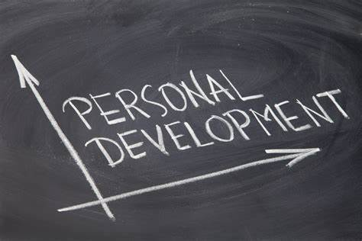
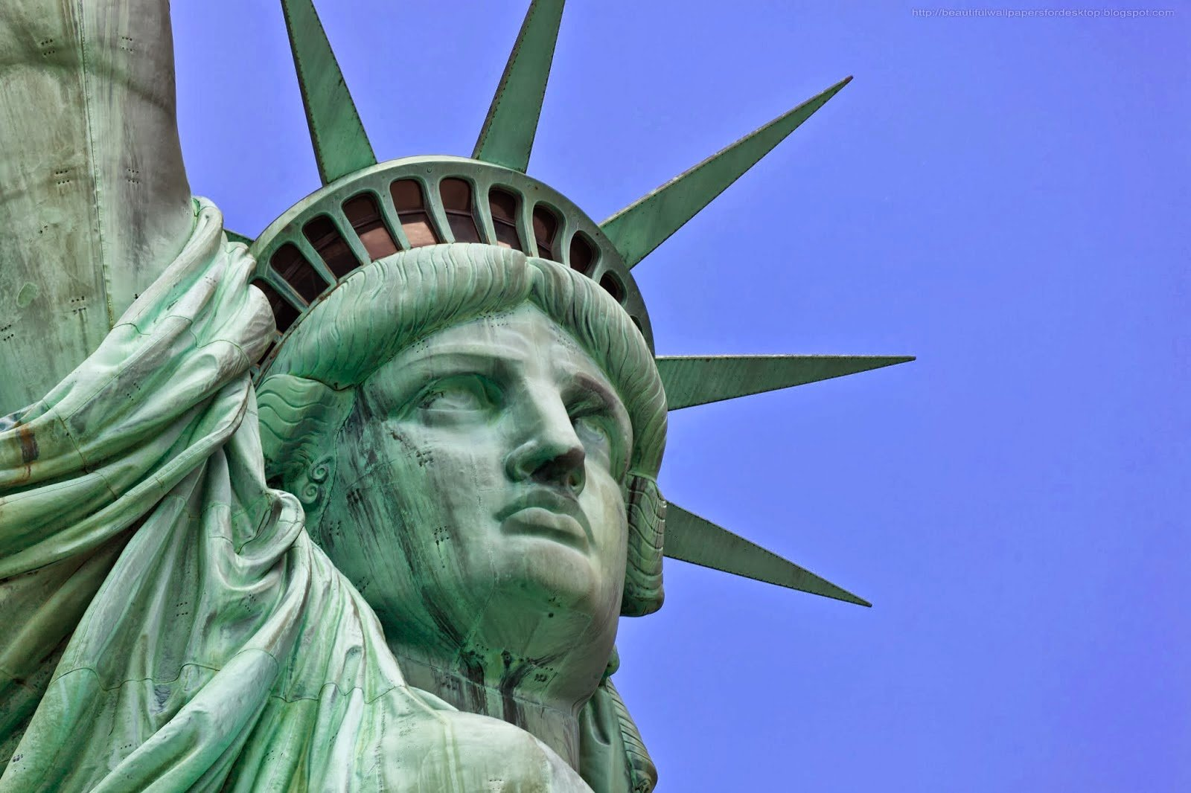
PERSONAL DEVELOPMENT
COURSE
PART 2:
AMERICAN SELF-RELIANCE / EXCEPTIONALISM

Slide 2
Learning Objectives of American Self-Reliance / Exceptionalism:
PERSONAL DEVELOPMENT
COURSE
2- AMERICAN SELF-RELIANCE / EXCEPTIONALISM
American Self-Reliance/Exceptionalism:
The young adult will be able to identify the meanings of America having been a
nation built on self-reliance & what made us exceptional.
Individual Initiative:
The young adult will be able to identify what it means to take initiative individually and being responsible ourselves for what happens in our life, with the exception of those things we cannot control.
Leaders that promote Self-Reliance:
The young adult will be able to identify and learn from past, present leaders, and patriots that taught us to be self-reliant.
Law of Self-Reliance:
The young adult will be able to identify the ‘Law of Self-Reliant’, to explain its meanings and how it should apply to his or her own life.

Slide 3
Learning Objectives of American Self-Reliance / Exceptionalism:
PERSONAL DEVELOPMENT
COURSE
2- AMERICAN SELF-RELIANCE / EXCEPTIONALISM
5. Practicing / Attaining Individual Self-Reliance:
The young adult will be able to identify self-reliance as a is a key part of an individual’s growth process; to understand one’s own ability and willingness to be capable.
Explore how you build that foundation for future productivity.
How one see’s an important link between self-reliance, community and society at large.
When we strive to be self-reliant, we seek to minimize the burden placed on others and maximize the burden placed on ourselves.
6. Practicing being an American:
The young adult will be able to identify the meanings of America having been a nation built on Self-Reliance & what made us Exceptional.
To be able to explain and give examples of practicing Americanism/Nationalism.
7. Ultimate = Serving One’s Country:
The young adult will be able to identify the various options of serving one’s country.

Slide 4
2- AMERICAN SELF-RELIANCE / EXCEPTIONALISM
Class Subjects:
Self-Reliance (our American Legacy).
Individual Initiative.
Leaders that promote Self-Reliance.
The Law of Self-Reliance.
Practicing or attaining Self-Reliance.
Practicing being an American.
Ultimate = Serving One’s Country.

Slide 5
PERSONAL DEVELOPMENT
COURSE
PART 2:
AMERICAN SELF-RELIANCE / EXCEPTIONALISM

Slide 6
2 - AMERICAN SELF-RELIANCE / EXCEPTIONALISM
Part A.
SELF-RELIANCE
(Our American Legacy)

Slide 7
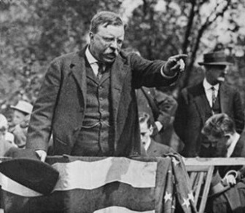
America built on Self-Reliance
2- AMERICAN SELF-RELIANCE / EXCEPTIONALISM
We have a history in American since its founding of being Self-Reliant – It’s part of legacy.
We were not built on men who relied on somebody else to take care of them.
It was built by men who relied on themselves.
Men who dared to shape their own lives.
Men who had enough courage to blaze new trails.
Men with enough confidence in themselves to take
the necessary risks.

Slide 8
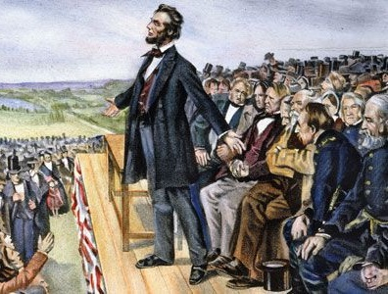
Self-Reliance is our American Legacy:
2- AMERICAN SELF-RELIANCE / EXCEPTIONALISM
It is the secret of something which stamped Americans as Americans.
It is called INDIVIDUAL INITIATIVE.
It is called BACKBONE.
But IT IS part of our National Character. (Historically speaking)

Slide 9
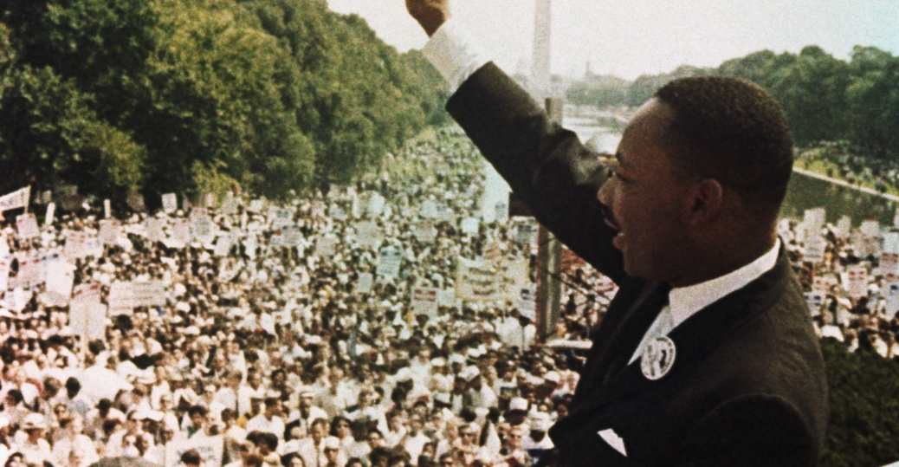
Today, it is apparent that we need to get it back…
2- AMERICAN SELF-RELIANCE / EXCEPTIONALISM
Reestablish the rights for which we stand.
Reinsert our rights to:
Human dignity
Self-respect
Self-reliance
Get on a path, of bring that Self-Reliance back, first Individually, then as a Nation.

Slide 10
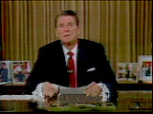
Today, it requires inspired LEADERS, in spirit and knowledge of problem areas
2- AMERICAN SELF-RELIANCE / EXCEPTIONALISM
We need to find leaders who promote self-reliance
Who practice it with strict devotion & understanding.
That is why you are here… being groomed as our future Warriors and Leaders.

Slide 11
2 - AMERICAN SELF-RELIANCE / EXCEPTIONALISM
Part B.
INDIVIDUAL INITIATIVE

Slide 12
Self-Reliance:
2- AMERICAN SELF-RELIANCE / EXCEPTIONALISM
Self-Reliance (our American Legacy)

Slide 13
2 - AMERICAN SELF-RELIANCE / EXCEPTIONALISM
Part C.
LEADERS THAT PROMOTE
SELF-RELIANCE

Slide 14
Self-Reliance:
2- AMERICAN SELF-RELIANCE / EXCEPTIONALISM
Self-Reliance (our American Legacy)

Slide 15
2 - AMERICAN SELF-RELIANCE / EXCEPTIONALISM
Part D.
THE LAW OF
SELF-RELIANCE

Slide 16
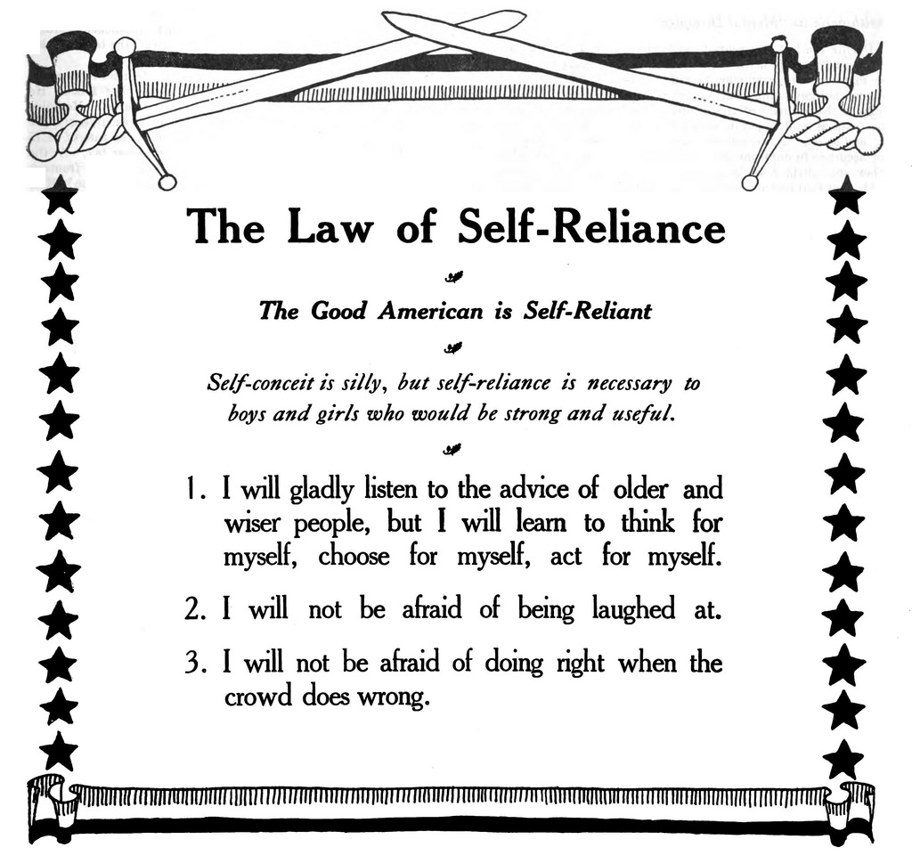
The Law of Self-Reliance:
2- AMERICAN SELF-RELIANCE / EXCEPTIONALISM
--- Author unknown… but published decades ago. One’s explanation of Self-Reliance.

Slide 17
The Law of Self-Reliance:
2- AMERICAN SELF-RELIANCE / EXCEPTIONALISM
--- A GUIDE FOR THE YOUTH OF AMERICA FOR DECADES, ARE THREE STATEMENTS OF WAY TO ACT TOWARDS YOUR OWN BEHAVIOR TOWARD TAKING RESPONSIBILITY FOR YOU OWN LIFE.
--- A GOOD AMERICAN IS SELF-RELIANT.
I will gladly listen to the advice of older, wiser people, but...
- I will learn to think for myself.
- I will learn to choose for myself.
- I will learn to act for myself.
--- If you know someone who is older, and has proven to you to be wiser, more knowledgeable, have gone thru things you never have, why would you not LEARN from them?

Slide 18
The Law of Self-Reliance:
2- AMERICAN SELF-RELIANCE / EXCEPTIONALISM
Too many times in America…
We seem to always waste our time in getting ahead by want to “Reinventing the Wheel.”
KNOW WHAT THAT MEANS!
It is also said a smart man know WHAT is going on, but a wise man knows WHY things are going on.
A WISE MAN also learns from the mistakes of others.
Do you spend 20-30 min to an hour reading the news and world events? Or NAAAHHH!

Slide 19
The Law of Self-Reliance:
2- AMERICAN SELF-RELIANCE / EXCEPTIONALISM
READING THE NEWS..
FYI… most of the Worlds news stories come out of the AP (Associated Press) or one of the Major News Companies in NY or the East Coast.
What you may not know, is most of the days stories ARE POSTED (via their sites on the Internet) by 11pm-Midnight (EST)
By 9-10pm West Coast time, you can in 15-30 min. read or scan a few sources before bed.
NEXT day you will READ or HEAR on radio/TV/Utube those same stories.
Go about your day, you already know 80-90% of what is going on.

Slide 20
The Law of Self-Reliance:
2- AMERICAN SELF-RELIANCE / EXCEPTIONALISM
2. I will not be afraid of being laughed at.
--- or do you get depressed or down because someone who is not your friend, or does not know you well, posts something negative or untrue on Social-media just to get you to respond, or that they can actually post something, and they won’t get repercussions with you in person.
--- Lighten up! Let it bounce off of you…

Slide 21
The Law of Self-Reliance:
2- AMERICAN SELF-RELIANCE / EXCEPTIONALISM
I will not be afraid of doing right when the crowd does wrong.
--- If you know an action is wrong, a strong person will
not deviate what they already know to be true!

Slide 22
2 - AMERICAN SELF-RELIANCE / EXCEPTIONALISM
Part E.
PRACTICING OR ATTAINING
SELF-RELIANCE

Slide 23
Practicing or Attaining the Art of Self-Reliance:
2- AMERICAN SELF-RELIANCE / EXCEPTIONALISM
Self-Reliance (our American Legacy)

Slide 24
2 - AMERICAN SELF-RELIANCE / EXCEPTIONALISM
Part F.
PRACTICING BEING AN AMERICAN

Slide 25
Self-Reliance:
2- AMERICAN SELF-RELIANCE / EXCEPTIONALISM
RESPONSIBILITIES

Slide 26
Self-Reliance:
2- AMERICAN SELF-RELIANCE / EXCEPTIONALISM
Self-Reliance (our American Legacy)

Slide 27
Self-Reliance:
2- AMERICAN SELF-RELIANCE / EXCEPTIONALISM
Self-Reliance (our American Legacy)

Slide 28
Self-Reliance:
2- AMERICAN SELF-RELIANCE / EXCEPTIONALISM
Self-Reliance (our American Legacy)

Slide 29
2 - AMERICAN SELF-RELIANCE / EXCEPTIONALISM
Part G.
ULTIMATE = SERVING ONE’S COUNTRY

Slide 30
Self-Reliance:
2- AMERICAN SELF-RELIANCE / EXCEPTIONALISM
Self-Reliance (our American Legacy)

Slide 31
Self-Reliance:
2- AMERICAN SELF-RELIANCE / EXCEPTIONALISM
Self-Reliance (our American Legacy)

Slide 32
2 - AMERICAN SELF-RELIANCE / EXCEPTIONALISM
END OF:
PERSONAL DEVELOPMENT-I
Part 2- American Self-Reliance / Exceptionalism

